Slide 1


About Cochrane
Trusted evidence.
Informed decisions.
Better health.

Slide 2
Who we are
Cochrane is a global independent network of over 36,000 researchers, professionals, patients, carers and people interested in health.
We respond to the challenge of making the vast amounts of best available evidence generated through research useful for informing decisions about health.
Cochrane is a not-for-profit organization with collaborators from more than 120 countries working together to produce credible, accessible health information that is free from commercial sponsorship and other conflicts of interest.

Slide 3
What is a systematic review?
A systematic review attempts to identify, appraise and synthesize all the empirical evidence that meets pre-specified eligibility criteria to answer a given research question. Researchers conducting systematic reviews use explicit methods aimed at minimizing bias, in order to produce more reliable findings that can be used to inform decision making.

Slide 4
What is a Cochrane Review?
Cochrane Reviews are systematic reviews of research in healthcare and health policy that are published in the Cochrane Database of Systematic Reviews. There are five types of Cochrane Review:
Intervention reviews assess the benefits and harms of interventions used in healthcare and health policy.
Diagnostic test accuracy reviews assess how well a diagnostic test performs in diagnosing and detecting a particular disease.
Methodology reviews address issues relevant to how systematic reviews and clinical trials are conducted and reported.

Slide 5
What is a Cochrane Review?
Qualitative reviews synthesize qualitative evidence to address questions on aspects other than effectiveness.
Prognosis reviews address the probable course or future outcome(s) of people with a health problem.
Cochrane Reviews base their findings on the results of studies that meet certain quality criteria, since the most reliable studies will provide the best evidence for making decisions about health care.

Slide 6

The Cochrane story

Slide 7
Our logo tells a story
The circle formed by two ‘C’ shapes represents our global collaboration.
The lines within illustrate the summary results from an iconic systematic review. Each horizontal line represents the results of one study, while the diamond represents the combined result, our best estimate of whether the treatment is effective or harmful.
The diamond sits clearly to the left of the vertical line representing “no difference”, therefore the evidence indicates that the treatment is beneficial. We call this representation a “forest plot”.

Slide 8
This forest plot within our logo illustrates an example of the potential for systematic reviews to improve health care. It shows that corticosteroids given to women who are about to give birth prematurely can save the life of the newborn child.
Despite several trials showing the benefit of corticosteroids, adoption of the treatment among obstetricians was slow. The systematic review published by Crowley et al., was influential in increasing use of this treatment. This simple intervention has probably saved thousands of premature babies.
During the past 20 years Cochrane has progressed the way healthcare decisions are made. And now we’re leading another change, as outlined by Strategy to 2020. A visible expression of this change is our new brand identity.

Slide 9
Our Vision and Mission
Our vision is a world of improved health where decisions about health and health care are informed by high quality, relevant and up-to-date synthesized research evidence.
Our mission is to promote evidence-informed health decision-making by producing high quality, relevant, accessible systematic reviews and other synthesized research evidence.

Slide 10
Cochrane exists so that healthcare decisions get better.
Over the past 22 years, Cochrane has helped to transform the way health decisions are made.
We produce reviews that summarize the best available evidence generated through research to inform decisions about health.
Our work is recognized as representing an international gold standard for high quality, trusted information.
We want to be the leading advocate for evidence-informed health across the world.

Slide 11


Organizational Reach
36,159 Cochrane contributors
107 countries with active authors
Author distribution:
  HIC 22,375
  UMIC 4,937
  LMIC/LIC 1,195
Translation communities actively working in 12 languages
Notes:
This is about demonstrating the reach of our organisation by the people contributing,

Slide 12
Cochrane’s organizational structure
Cochrane Steering Group
Central Executive Team
52 Review Groups
16 Methods Groups
40 Centres and Branches
11 Fields
Consumers Network
Notes:
Can we make this more exicting!?

Slide 13
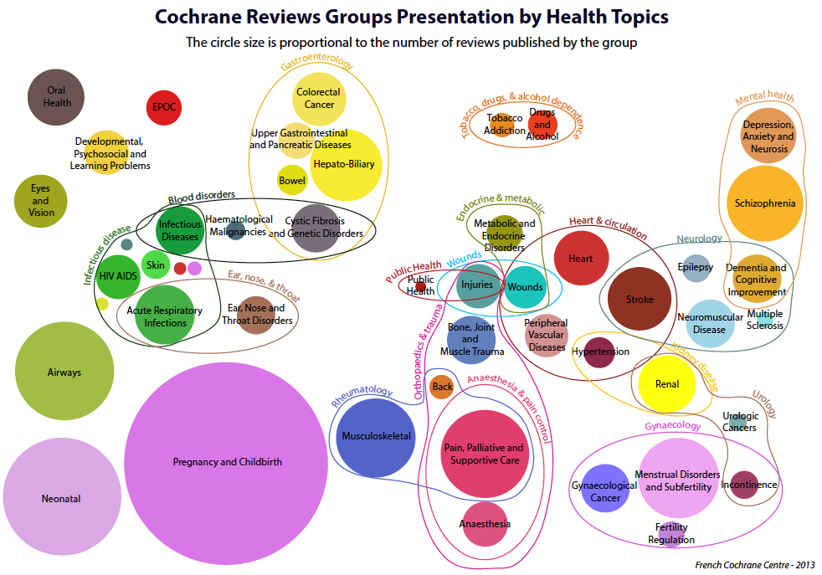
Cochrane Review Groups by health topic. The circle size is proportional to the number of reviews published by the group
Notes:
This is about demonstrating the reach of our organisation by topic coverage

Slide 14


Reputational Audit
Showed us that generally Cochrane and our reviews are seen as the ‘gold standard’
Robust methodology
Comprehensive studies
100% independent
Respected name
International reach
Passionate and enthusiastic reviewers

Slide 15
Our Strategy to 2020 has 4 Goals
Goal 1: Producing evidence
To produce high quality, relevant, up-to-date systematic reviews and other synthesized research evidence to inform health decision-making.
Goal 2: Accessible evidence
To make Cochrane evidence accessible and useful to everybody, everywhere in the world.
Goal 3: Advocating for evidence
To make Cochrane the ‘home of evidence’ to inform health decision-making, build greater recognition of our work, and become the leading advocate for evidence-informed health care.
Goal 4: Building an effective and sustainable organization
To be a diverse, inclusive and transparent international organization that effectively harnesses the enthusiasm and skills of our contributors, is guided
by our principles, governed accountably, managed efficiently, and makes optimal use of its resources.

Slide 16
Some Key Objectives: Goal 1
HIGH-QUALITY:
We will continue to develop and implement comprehensive quality assurance mechanisms for editorial and methodological standards throughout our production and updating processes.
RELEVANT:
We will engage with patients and other healthcare consumers, health practitioners, policy-makers, guidelines developers and research funders to identify questions that are most relevant and important to them; and prioritise the production and updating of Cochrane Systematic Reviews accordingly.
UP-TO-DATE:
We will ensure that Cochrane Systematic Reviews represent the best evidence currently available by establishing and managing performance against updating targets, particularly for high priority reviews.

Slide 17
Some Key Objectives: Goal 1
WIDE COVERAGE:
We will continue to support the production of Cochrane Systematic Reviews across a broad range of questions in order to develop the widest possible body of reliable knowledge about health.
PIONEERING METHODS:
We will ensure that established methods are applied consistently and appropriately in Cochrane Systematic Reviews; and continue to develop innovative methods for designing and conducting research evidence synthesis that help us to achieve our mission.

Slide 18
Principles
1 Collaboration
by fostering global co-operation, teamwork, and open and transparent communication and decision-making.
2 Building on the enthusiasm of individuals
by involving, supporting, and training people of different skills and backgrounds.
3 Avoiding duplication of effort
by good management, co-ordination and effective internal communications to maximize economy of effort.
4 Minimising bias
through a variety of approaches such as scientific rigour, ensuring broad participation, and avoiding conflicts of interest.

Slide 19
Principles
5 Keeping up to date
by a commitment to ensure that Cochrane Systematic Reviews are maintained through identification and incorporation of new evidence.
6 Striving for relevance
by promoting the assessment of health questions using outcomes that matter to people making choices in health and health care.
7 Promoting access
by wide dissemination of our outputs, taking advantage of strategic alliances, and by promoting appropriate access models and delivery solutions to meet the needs of users worldwide.

Slide 20
Principles
8 Ensuring quality
by applying advances in methodology, developing systems for quality improvement, and being open and responsive to criticism.
9 Continuity
by ensuring that responsibility for reviews, editorial processes, and key functions is maintained and renewed.
10 Enabling wide participation
in our work by reducing barriers to contributing and by encouraging diversity.

Slide 21
Key Cochrane partnerships
World Health
Organization

Slide 22
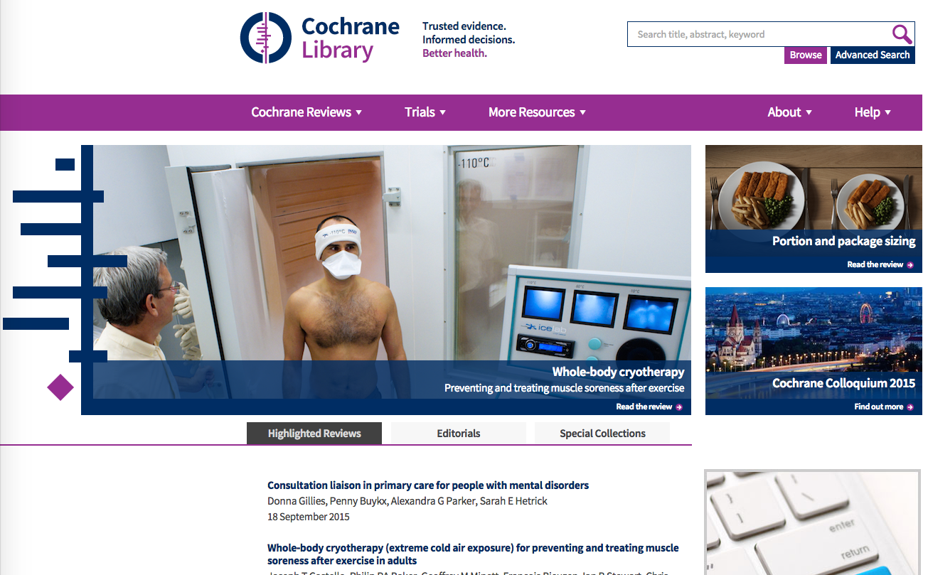
Cochrane Library
cochranelibrary.com
Notes:
Can we show cochrane.org here – homepage??

Slide 23

Cochrane Library
The Cochrane Library is a collection of six databases that contain different types of high quality, independent evidence to inform healthcare decision-making, and a seventh database that provides information about Cochrane groups.
Systematic reviews are our main publication. They are published electronically in full text in the Cochrane Library. The abstracts and plain language summaries of all Cochrane Reviews are also freely available on cochrane.org
All Cochrane Reviews are published in the Cochrane Database of Systematic Reviews in the Cochrane Library – cochranelibrary.com

Slide 24
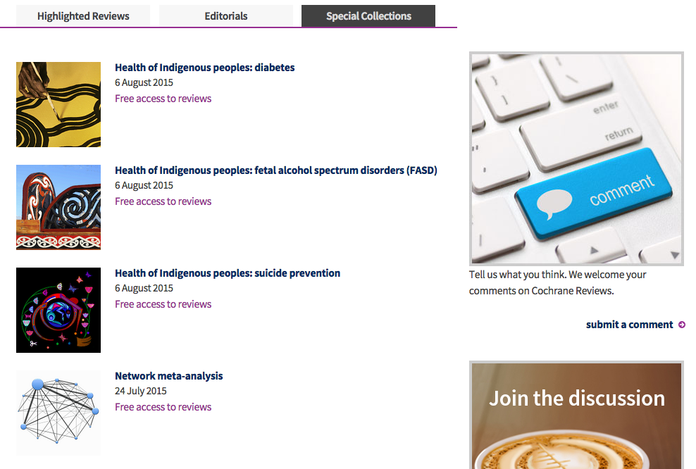
Additional content
cochranelibrary.com
Notes:
And here we have examples of curated and additional content: these are Special Collections of reviews that have some connection to one another and which we bring together with a short commentary, and in many cases make the reviews freely available for a period of time.

Slide 25
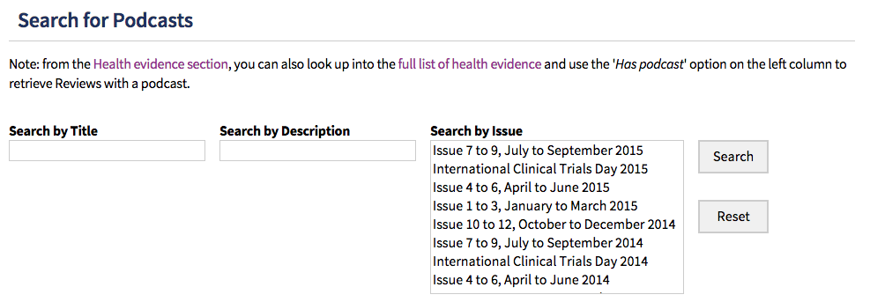

Additional content
Podcast library and the Journal Club
Notes:
And here we have examples of curated and additional content: these are Special Collections of reviews that have some connection to one another and which we bring together with a short commentary, and in many cases make the reviews freely available for a period of time.

Slide 26
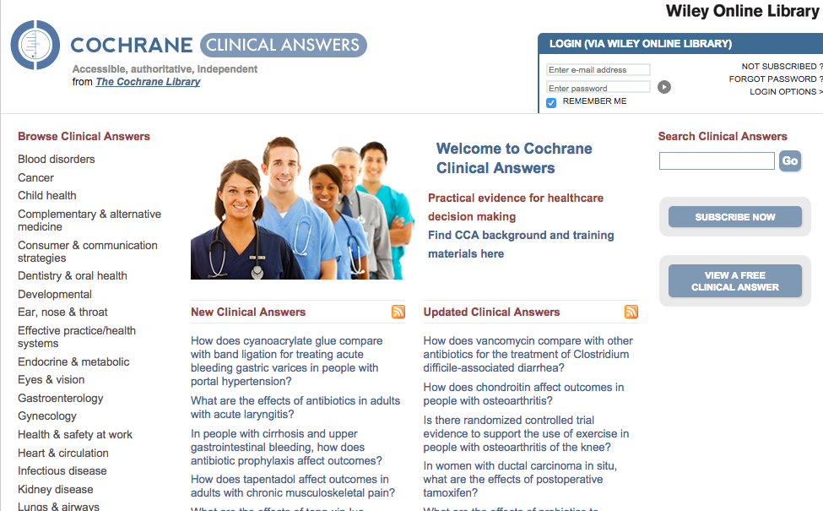
Derivative products & services
cochraneclinicalanswers.com
Notes:
And lastly we have looked extensively into creating separate derivative products. These can be either Q&A services such as this, or products aimed at creating Continuing Professional Development opportunities for readers. It is only fair to say that we are at a fairly early stage in this area, but we see other products such as BMJ Learning, and other journals such as the NEJM leading the way in providing such additional services for readers.

Slide 27
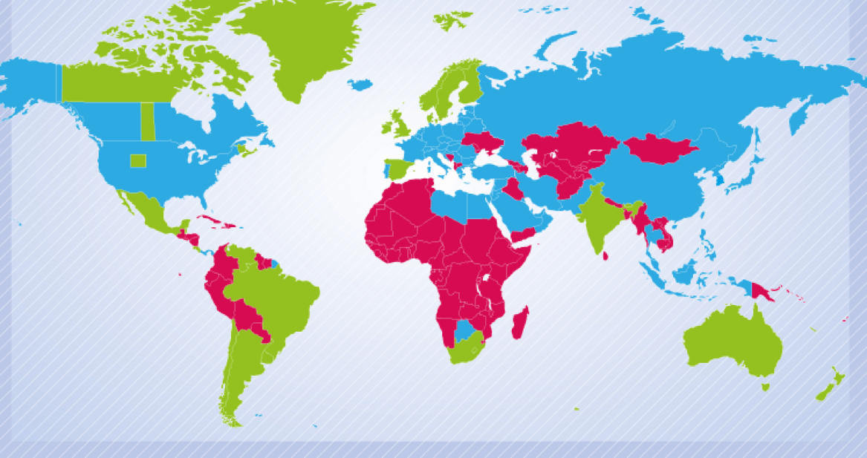

Geographical reach and access
3.66 billion people have free access in 148 countries
Notes:
Holly – can we find a better map to show our reach and access

Slide 28
Where are we now?
Open access (OA):
Gold OA model:
Full OA “author pays” model
Creative Commons licence ie cc-by-nc
Green OA model:
All new and updated reviews will be free to access 12 months after publication
Author retains copyright
Reviews will be deposited in PubMed Central or equivalent
Notes:
These would be optional slides about open access – can we make this more on-brand?

Slide 29
Where are we now?
Open access (OA):
Gold OA model:
Full OA “author pays” model
Creative Commons licence ie cc-by-nc
Green OA model:
All new and updated reviews will be free to access 12 months after publication
Author retains copyright
Reviews will be deposited in PubMed Central or equivalent
By the end of 2014:
903 reviews green OA
20 reviews gold OA
Notes:
These would be optional slides about open access – can we make this more on-brand?

Slide 30
The Cochrane Database of Systematic Reviews
High quality systematic reviews to inform decision making:
6000+ reviews
40 new reviews / 45 updates per month
Notes:
Our strategy to 2020 covers 4 areas, but the first two of these reflect our primary purpose: to produce and maintain high quality, relevant systematic reviews, and to do everything we can to ensure that they impact on health care across the world.
The Cochrane Database of Systematic Reviews, which is the Journal, is one of the databases within the Cochrane Library – which also includes the CENTRAL register of controlled trials.
The CDSR comprises over 6000 reviews and each month we publish around 40 new reviews and 45 updates. Parenthetically, in 2013 we moved to a continuous publication model from the monthly cycle I introduced shortly after arriving. Looking back now, I am pleased we did it – at the time I might not have been quite so positive! Each publication has an update associated with an issue – based on the old monthly cycle.

Slide 31
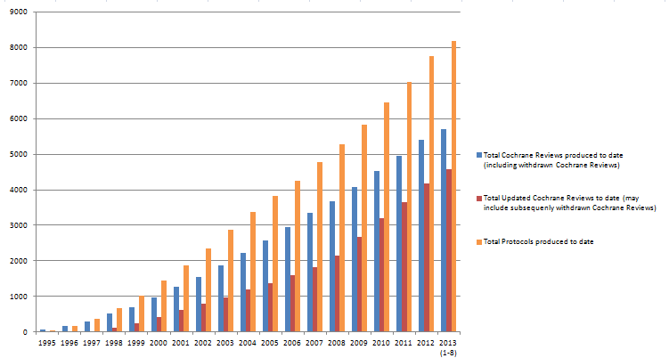
The Cochrane Database of Systematic Reviews
Notes:
Our strategy to 2020 covers 4 areas, but the first two of these reflect our primary purpose: to produce and maintain high quality, relevant systematic reviews, and to do everything we can to ensure that they impact on health care across the world.
The Cochrane Database of Systematic Reviews, which is the Journal, is one of the databases within the Cochrane Library – which also includes the CENTRAL register of controlled trials.
The CDSR comprises over 6000 reviews and each month we publish around 40 new reviews and 45 updates. Parenthetically, in 2013 we moved to a continuous publication model from the monthly cycle I introduced shortly after arriving. Looking back now, I am pleased we did it – at the time I might not have been quite so positive! Each publication has an update associated with an issue – based on the old monthly cycle.

Slide 32

Metrics

Slide 33
Metrics
Year | Rank | Impact Factor | In-Windows Cites | Citable items | Total cites | Self-citation rate | 5-Year Impact Factor
2013 | 10 | 5.939 | 9859 | 1660 | 39,856 | 8% | 6.706
2012 | 12 | 5.785 | 8087 | 1398 | 34,230 | 8% | 6.553
2011 | 10 | 5.912 | 7721 | 1306 | 29,593 | 5% | 6.309

Slide 34
Metrics
Year | Rank | Impact Factor | In-Windows Cites | Citable items | Total cites | Self-citation rate | 5-Year Impact Factor
2013 | 10 | 5.939 | 9859 | 1660 | 39,856 | 8% | 6.706
2012 | 12 | 5.785 | 8087 | 1398 | 34,230 | 8% | 6.553
2011 | 10 | 5.912 | 7721 | 1306 | 29,593 | 5% | 6.309

Slide 35
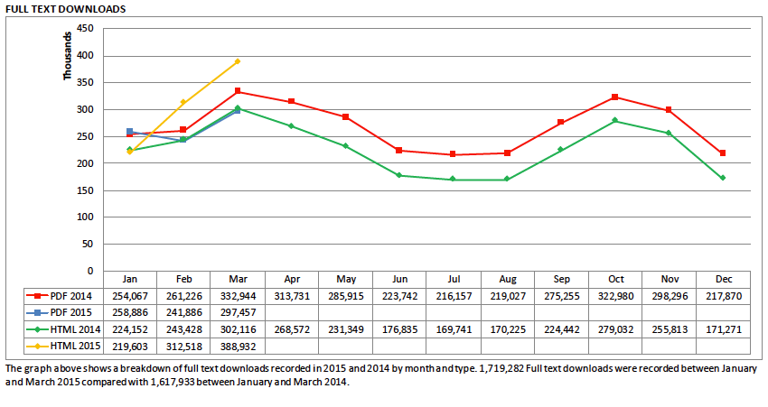
Metrics
Usage in 2015 (January to March)

Slide 36
Cochrane Reviews
Introduction
How titles are selected
The editorial process
Key components
Quality assurance / methodological expectations
Updating

Slide 37
Cochrane Reviews
Intervention reviews (clinical and non-clinical)
Diagnostic Test Accuracy
Overviews of reviews
Qualitative reviews
Soon to come… Prognosis Reviews

Slide 38
How titles are selected
From passive to active: transformation
Engagement with stakeholders
  James Lind Alliance priority setting partnerships
  Guidelines groups
  Funders
  Health professionals
  Patient groups

Slide 39

2015 Priority list
300+ reviews
Mainly submitted by CRGs
Engagement with research funders
and policy makers
Dynamic process!
cochrane.org/news/updated-list-cochrane-priority-reviews-now-available

Slide 40
The Cochrane process
Title
Protocol
Review
Editorial process
Define question
Competence of author team
PICO
Plan search
Describe methods
Peer review
Publish
Undertake search
Screen results
Identify included studies
Risk of bias of included studies
Extract and analyse data
Write up and submit
Peer review
Revision
Copy edit
Publish
Updating

Slide 41
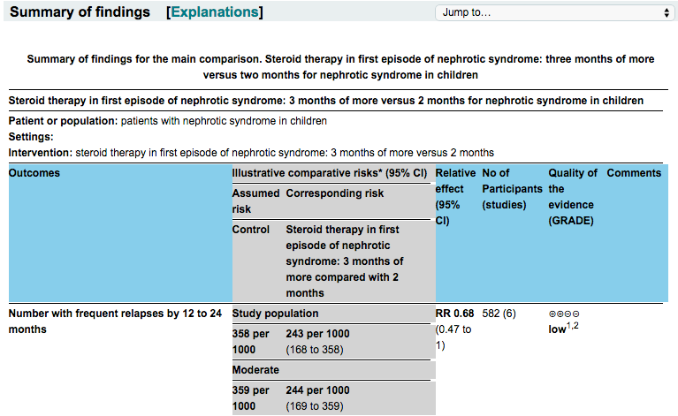
Key elements of Cochrane Reviews
PICO structure

Slide 42
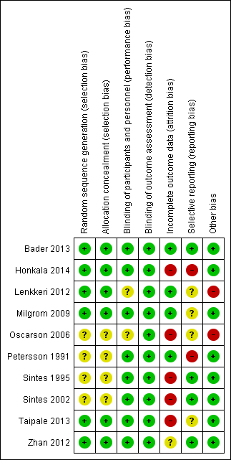
Key elements of Cochrane Reviews
PICO structure

Slide 43
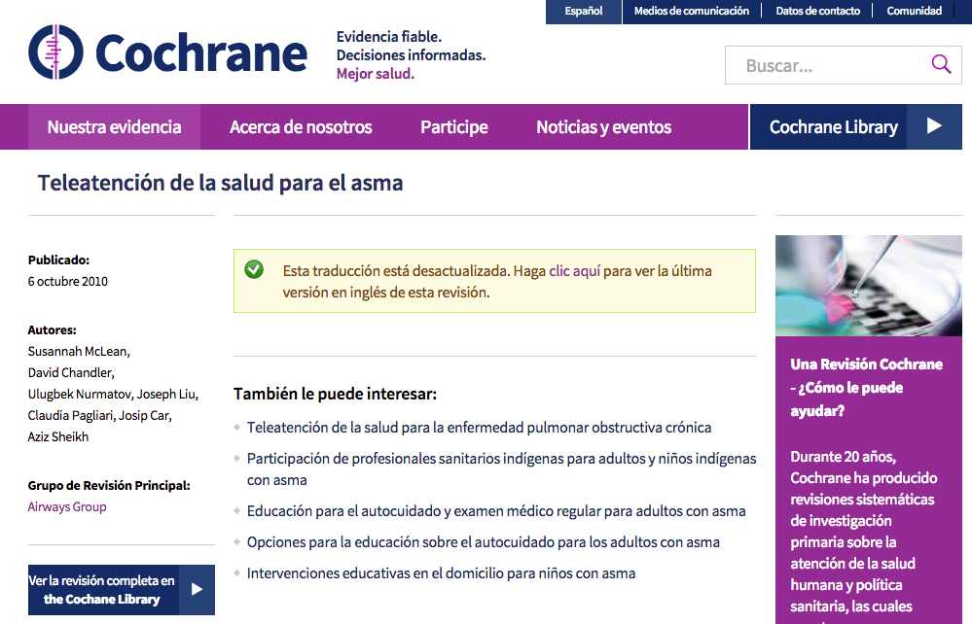
Key elements of Cochrane Reviews
cochrane.org translated into Spanish

Slide 44

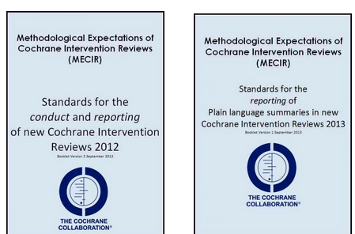

Quality assurance

Slide 45
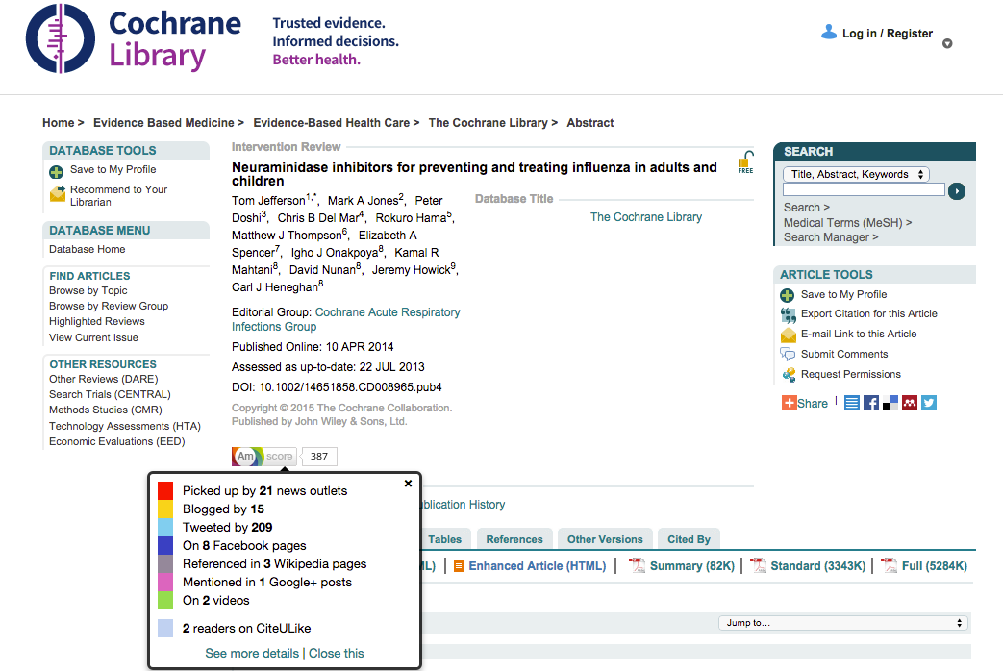
Communicating the impact Cochrane Reviews have made
Altmetric impact data within a Cochrane Review
Notes:
These impact slides will change as we add in newer case –studies – ie the WHO infographic and the Child health case study.

Slide 46
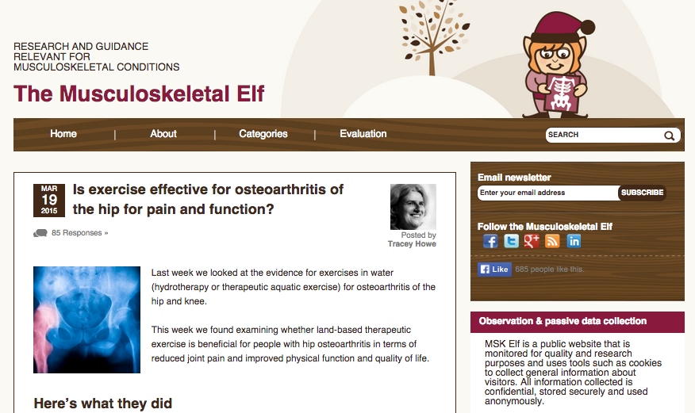
And a little help from our friends
nationalelfservice.net/musculoskeletal
Notes:
And here is a good example of how in our networked world content can fly: here is a blog on the Musculoskeletal Elf site by Tracey Howe commenting on a review. So here an article can have impact via an indirect source that may be better plugged in to a key community – in this case health professionals

Slide 47

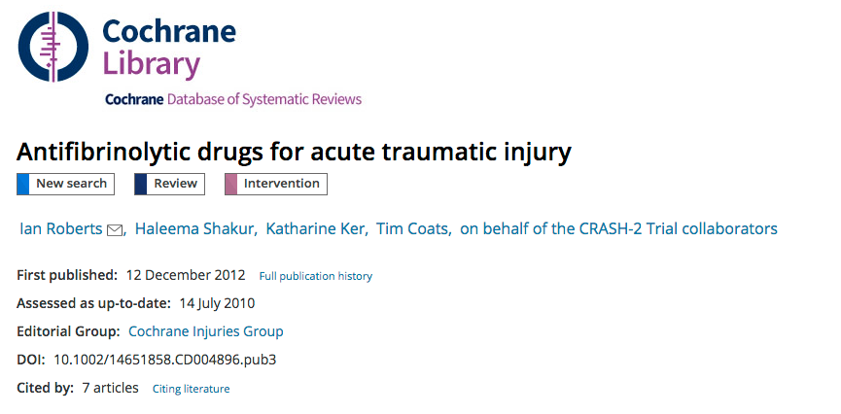
Anti-fibrinolytics in trauma

Slide 48

Avastin for macular degeneration
https://youtu.be/G17R6UXINNc

Slide 49

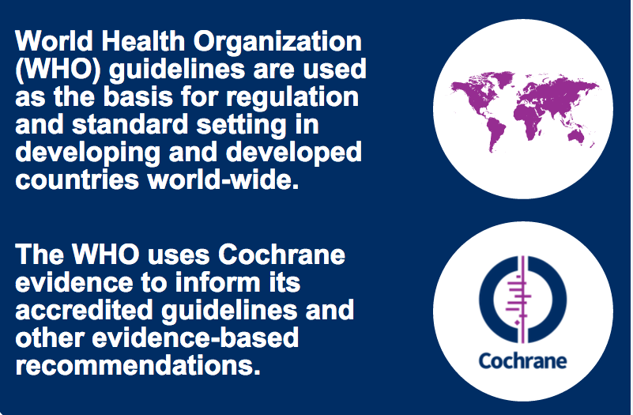
World Health Organization guidelines infographic
magic.piktochart.com/output/6769004-who-guidelines-infographic

Slide 50


Don’t go large! Portion size infographic
evidentlycochrane.net/portion-size, Cochrane UK

Slide 51



Not always about the big-hitters

Slide 52
Working with guidelines groups
Institute of Medicine guidance
What do we know already?
What’s in it for Cochrane?
Recent experiences and learning
Our goals

Slide 53
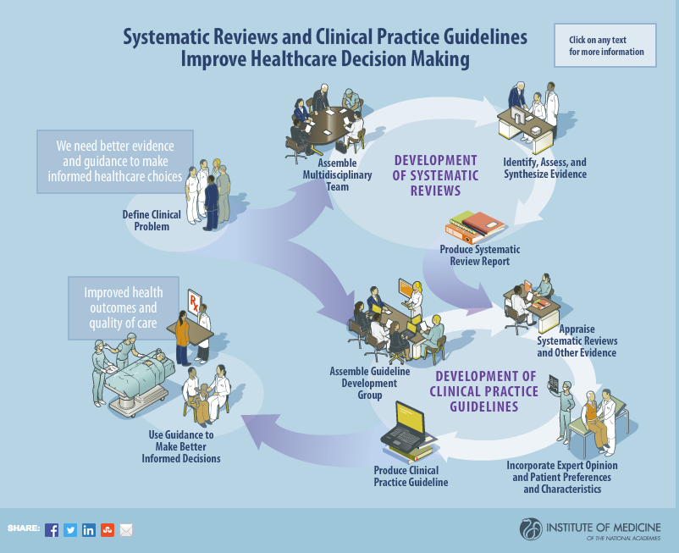

Slide 54
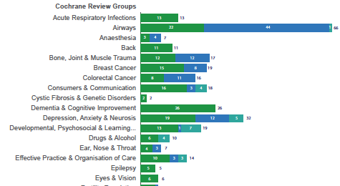
1158 Cochrane Reviews used to inform 238 clinical guidelines:
maximum 49 reviews in one guideline (SIGN asthma guideline, number 101)

Slide 55
Recent experiences
Vitamin A guidelines for WHO
  Important to set the parameters
    PICOs
    Types of studies
  Stimulus for the review authors
  Timeliness challenges
  Unanticipated benefit of having review authors in the guidelines meeting

Slide 56

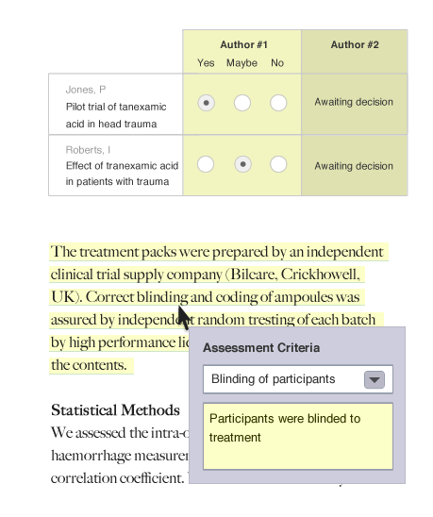
Technology and crowds: the “living review”
Project Transform
4 elements:
Pipeline
Getting involved
Information exchange
New production processes

Slide 57



The “living review”
“How much of what you do would be different if we could achieve even a 1 log (90%) reduction in time to produce a review or a review update?”
Julian Elliott

Slide 58
Translating Cochrane

Slide 59

Why translate?
magic.piktochart.com/output/6916280-cochrane-translations-infographic

Slide 60
Why translate?
Our vision is a world of improved health where decisions about health and healthcare are informed by high-quality, relevant and up-to-date synthesized evidence.

Slide 61

Cochrane translations
magic.piktochart.com/output/6916280-cochrane-translations-infographic

Slide 62

Our 3 most translated Reviews
magic.piktochart.com/output/6916280-cochrane-translations-infographic

Slide 63

cochrane.org

Slide 64
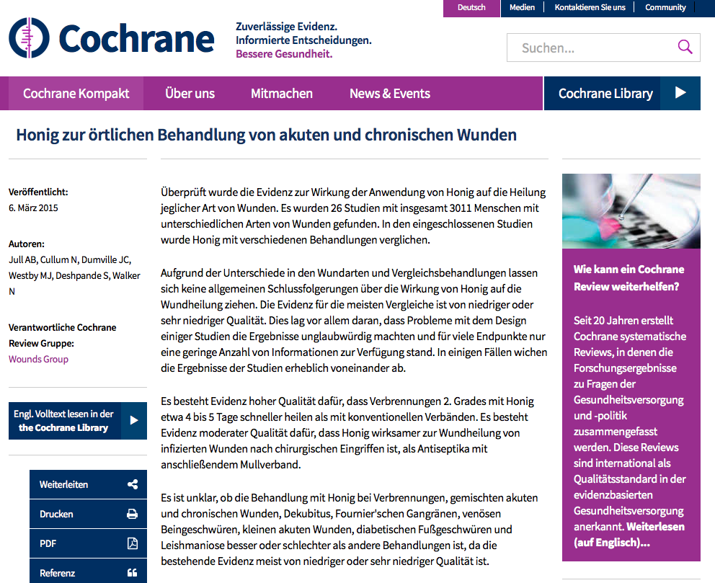
cochrane.org/de

Slide 65
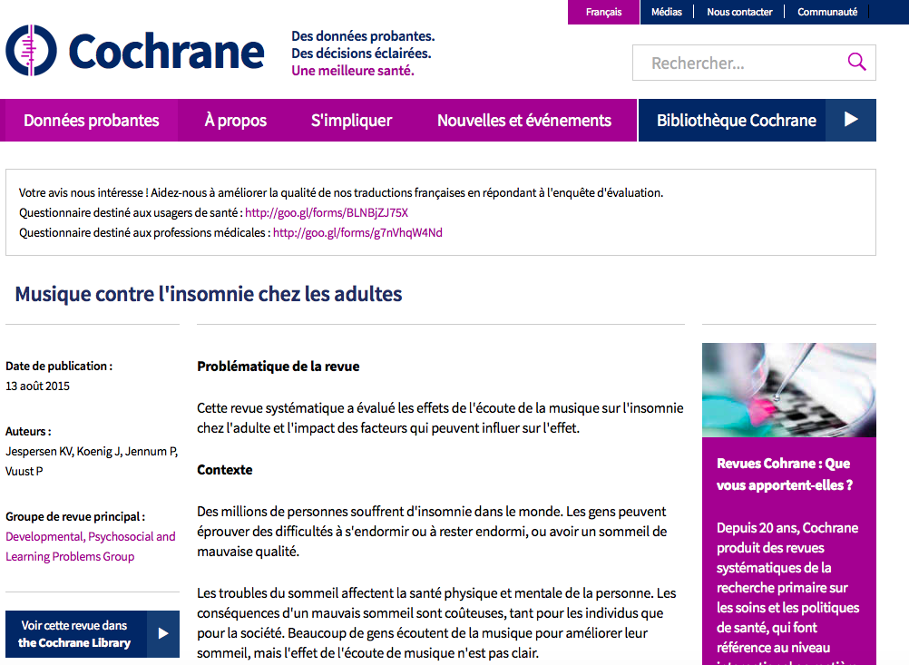
cochrane.org/fr

Slide 66
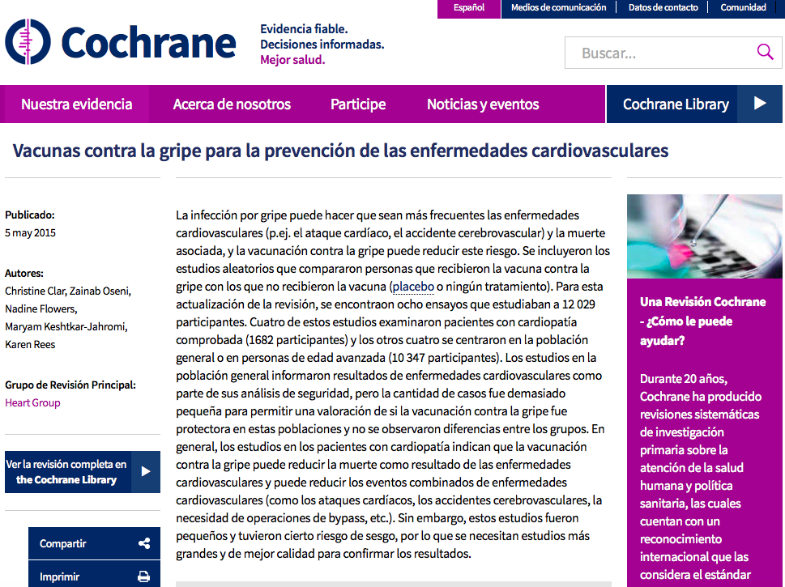
cochrane.org/es

Slide 67
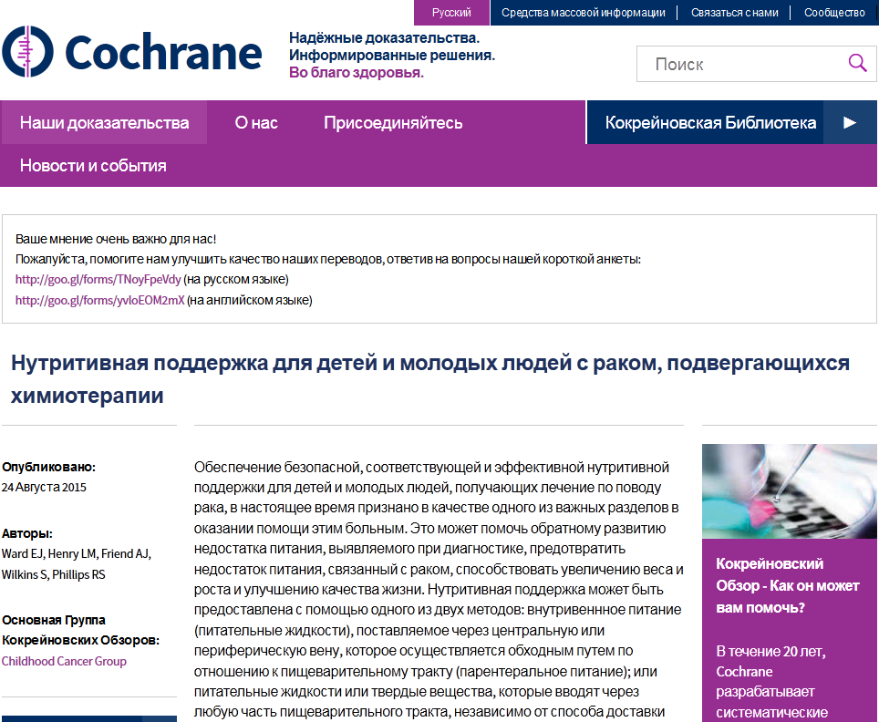
cochrane.org/ru

Slide 68

cochrane.org/zh-hans

Slide 69
