Slide 1

جستجو در منابع الکترونیک و آشنایی با سامانه نوپا
گروه هدف: اعضای هیئت علمی و پژوهشگران دانشجویان دانشگاه
دانشگاه علوم پزشكي و خدمات بهداشتي و درماني البرز
معاونت تحقیقات و فناوری
پاییز 1402
سوسن شاه خدابنده مسئول کتابخانه مرکزی دانشگاه؛ دانشجوی دکتری علم اطلاعات و دانش شناسی

Slide 2
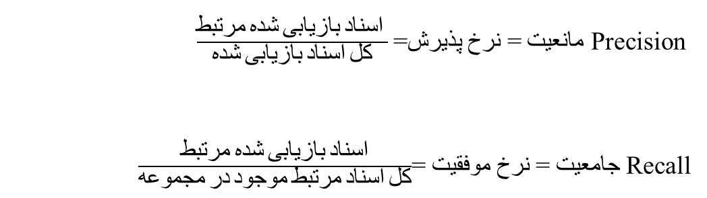
الف | ب | ج
+ + + + + + + + + + + + + + + ++ + + + + + + + + + + + + + +++++++++++++++++++++++++++++++++ +++++++++++++++++++++ ++++++++++++++++++++++++ +++++++ | +-+-+-+-+-+-+-+-+-+-+-+-+-+-+-+-+-+-+-+-+-+-+-+-+-+-+-+-+-+--+-+-+-+-+-+-+-+-+-+-+-+-+-+-+-+-+-+-+-+--+-+-+-+--+-+-+-+-+-+-+-+-+--+-+--+-+--+-+-+--+---+-+--+-+-+--+-+--+- | ----+---+-+-+-+------+---+----+++++-----------++ + +-- + ---- ---- ---+ - + -+ +------- + + + +---- +--- ---
150=+ 30=+ | 40=+ | 10=+
30=+ 0=- | 20=- | 50=-
Precision مانعیت = نرخ پذیرش=$\frac{مرتبط شده بازیابی اسناد }{شده بازیابی اسناد کل}$
Recall جامعیت = نرخ موفقیت =$\frac{ مرتبط شده بازیابی اسناد }{مجموعه در موجود مرتبط اسناد کل}$

Slide 3
steps
Understand basic database structure
Understand Using of
  Boolean Logic
  Field Searching
  Controlled Vocabulary
  Specialty techniques (truncation, etc.)
Formulate your question
Building your search strategy

Slide 4
Forget simple search
Advanced search
  Narrowing the search
  Boolean
  Phrase searching
  Field search
  Truncation
Simple search
  Very broad
  retrieves thousands of irrelevant files

Slide 5
Boolean Operators
British mathematician named George Boole (1815-1864)
Standard Boolean Logic for database searching uses 3 relationships among search terms.
AND
OR
NOT
It is both simple and powerful.

Slide 6
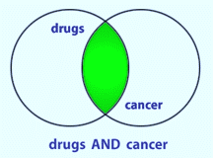
AND
BOTH terms included in any results.
If a record has only one of the two terms, it will not be retrieved.
If the record has neither term, it will not be retrieved.
What does this do to the amount of records retrieved?

Slide 7
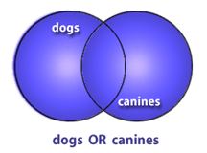
OR
Only one (NOT both) of the terms are in the results
‘OR’ will retrieve the record if both are included.
What does OR do to the amount of records retrieved?

Slide 8
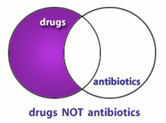
NOT
Excludes any results containing the term
Records containing both will not be retrieved.
What does NOT do to the amount of records retrieved?

Slide 9
Putting Them Together
Identify the concepts (Parse the question)
List specific terms for each concept
Put the terms for each concept in an OR statements within parentheses
Combine OR statements with AND
Add any NOT statements to the end

Slide 10
Nesting
salmonella AND hamburger OR eggs
salmonella AND (hamburger OR eggs)

Slide 11
Parsing the Question
What are the main concepts in your question?
Sample question:
Does nutrition therapy improve decubitus (pressure) ulcer healing in an elderly patient?
Concepts:
Decubitus/pressure ulcers
Nutrition therapy
Treatment
Ulcer healing
Elderly patients

Slide 12
Creating a Boolean Search
QUESTION: Is Vitamin C helpful in treating the flu?
Identify concepts and list terms
Concept 1 Influenza | Concept 2 Vitamin C | Concept 3 Treatment
Influenza | Vitamin C | Treatment
Flu | Ascorbic acid | Therapy
 | Orange Juice | Management

Slide 13
2. Make your OR statements, one per concept
  (influenza OR flu)
  (vitamin C OR ascorbic acid OR ascorbate)
  (treatment OR therapy OR management)

Slide 14
3. Put “AND” between each of the OR statements
(influenza OR flu) AND (vitamin C OR ascorbic acid OR orange juice) AND (treatment OR therapy OR management) AND (outcome OR recovery OR success)
4. Consider any NOT statements you might want to add.
Note: NOT isn’t used very often

Slide 15
Final Notes on Fields
Each database provides its own specific fields
Each database requires a specific format to designate field searching
When searching a new database, take a moment to read the help documentation; most will provide a list of fields and how to search them.

Slide 16
Truncation
What about including the singular and plural versions of words as well as other word variations?
For example: therapy, therapies, therapeutics
You could combine them all in an OR relationship:
(therapy OR therapies OR therapeutics OR therapeutic)

Slide 17
But an easier way is by the use of truncation.
therap*
Each database handles truncation in a unique way.
The ‘*’ and ‘$’ are the most common wildcard symbols.

Slide 18
Be cautious when truncating!
If the word stem is too short, there may be too many possible variations and you might pick up unrelated terms.
For example, using proc* for finding procaine-like drugs will also include words like proceedings and process.

Slide 19
Phrase Searching
Sometimes you want to force the database to search for a set of words in exact order
“fever of unknown origin”
“World health organization”
Most databases will accept a phrase in quotes.

Slide 20
Limits Options
Many databases provide “limits” pages that make it easier for you to select common options such as language, article type, publication dates, human or animal, gender, age groups, etc.
Each database’s limits options are unique
Most limits can be done ‘by hand’ using field tags, but sometimes limit pages save time

Slide 21
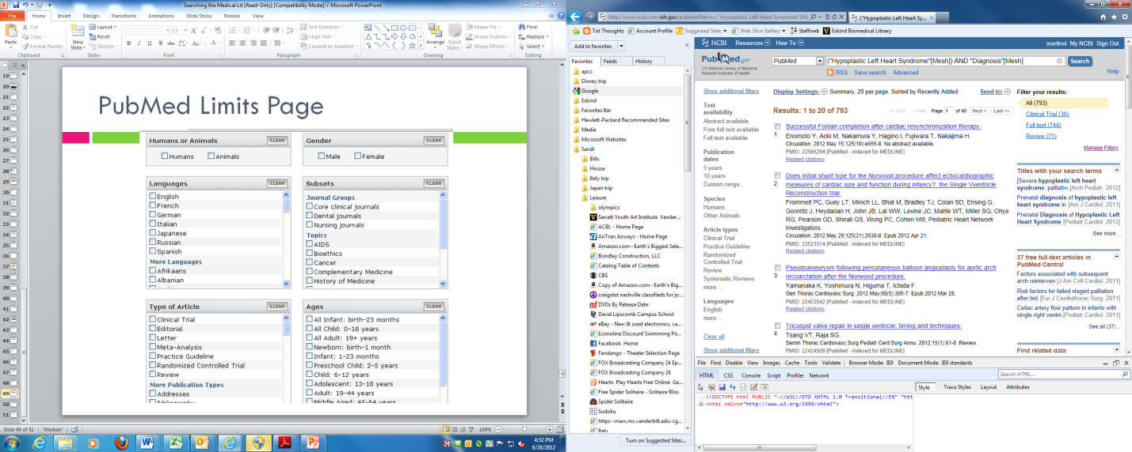
PubMed Limits Page

Slide 22
Step-By-Step Search Construction
State the question
Identify the concepts in the question
For each concept, determine keywords and subject terms
Specify field tags after terms if needed
Combine terms for the same concept with “OR” in parenthesis
Combine “OR” statements with AND
Put any NOT terms at the end
Keep track of your searches, how many articles were found total, and how many you selected as relevant

Slide 23
Types of Scientific Database

Slide 24
3 type of databases
Bibliographic databases
Citation databases
EBM databases

Slide 25
Bibliographic databases
A bibliographic database is a database of bibliographic records, an organized digital collection of references to published literature, including journal and newspaper articles, conference proceedings, reports, government and legal publications, patents, books, etc.
A bibliographic database may be general in scope or cover a specific academic discipline like medical science.

Slide 26
Examples of bibliographic databases
PubMed
Embase
Science Direct
LitCovid
Cochrane Library
Emerald
….

Slide 27
Citation databases
Citation databases compile the citations in the reference lists (bibliographies) of scholarly publications.
Citation database records also include bibliographic content that identify a publication: article title, journal name, author, abstract, etc.
Why use a citation database?
  Citation databases enable you to find newer papers that reference a paper or author you already know about. You might want to do this in order to:
  trace how an idea has been confirmed, applied, extended or corrected in later publications
  see which other researchers are citing your work or the work of your labmates
  find citation numbers and metrics to report on job or grant applications, evaluations, etc.

Slide 28
Three major databases allow interdisciplinary citation searching:
  Web of Science (WoS)
  Scopus
  Google Scholar (Search engine)
What's the Difference?
  WoS covers many fewer journal than Scopus, but it selects only "top tier" journals: those most likely to publish major scholarly papers.
  Scopus covers more journals and more international journals than does WoS.
  Google Scholar only includes papers if they have online abstracts or full-text. No one knows how much of the scholarly literature they cover. With Google Scholar, you can't know what you are missing.

Slide 29
Do you need to identify core articles published before the dawn of the Internet?
  WoS has full citation data for every paper it indexes back to 1900; Scopus has that data back to 1996. We don't know how far Google Scholar goes back.
Do you need accurate citations for your paper's reference list or a bibliography?
  It's better to use Web of Science or Scopus. Citation errors occur in all databases, but Google Scholar's bibliographic information is extracted by robots performing an automated Web search. This system may lead to incorrect identification of bibliographic information, especially if metadata on publisher Web sites is irregular. You may notice citation errors and/or duplicate citations when you search Google Scholar.
How do you think the information you need will have been published?
  Google Scholar covers many more types of documents than WoS and Scopus, e.g., dissertations, books, technical reports and more. Google Scholar is great when you are looking for more than journal articles.

Slide 30
Compares the coverage of Web of Science, Scopus, and Google Scholar
COVERAGE | Web of Science | Scopus | Google Scholar
Journal Content | 12,000+ journals | 21,000+ journals | Google Scholar indexes individual papers, not journals. It does not specify how many papers it indexes.
Coverage | 1900 to present, coverage varies by title | 1996 to present for 60% of content, remaining 40% of content dates back further, as far back as the 1820s in some cases. | Not specified.
Specialty Areas | Interdisciplinary: Chemistry, medicine, science, social science, arts & humanities | Interdisciplinary: science, technology, medicine, social sciences and arts & humanities | Not specified.
Comments | WoS also includes over 30,000 books, and conference proceedings for a large but unspecified number of conferences. | Scopus also includes metadata for over 16,000 books and cross-searches 25.2 million patents from five patent offices (US Patent & Trademark Office, European Patent Office, Japan Patent Office, World Intellectual Property Organization and the UK Intellectual Property Office) | The Google Scholar about page indicates it indexes, "journal and conference papers, theses and dissertations, academic books, pre-prints, abstracts, technical reports, court opinions, patents, and other scholarly literature from all broad areas of research." For more info, visit

Slide 31
Search Functionality in Web of Science, Scopus, and Google Scholar
SEARCH FEATURES | Web of Science | Scopus | Google Scholar
Search by Author Article Title, etc. (Field Searching) | Yes | Yes | Yes, on Advanced Search page, but options quite limited compared to those offered on Web of Science and Scopus.
Use Search Operators (Boolean Searching) | Yes | Yes | Yes, on Advanced Search page.
View References (Bibliographies) of Papers | Yes | Yes | No
Find "Related Articles" Based on Shared Citations | Yes | Yes | Unknown; Google Scholar finds Related Articles based on "similarity" and "relevance", but it is not known how this is calculated.
Sort Search Results by the Times Each Publication was Cited | Yes | Yes | There is no "Sort by times cited" feature like you'll find on Web of Science and Scopus
Search Alerts | Yes | Yes | Yes
Export to Bibliographic Managers (EndNote, RefWorks, etc.) | Yes | Yes | Yes, but only one citation at a time (unlike Web of Science and Scopus which let you export a group of citations at once).

Slide 32
Citation Analysis in Web of Science, Scopus, Google Scholar
 | Web of Science | Scopus | Google Scholar
Article Level Analysis | Citation Map feature allows you to visualize citing or cited papers by author, subject, publication year and more. | Citation Overview feature allows you to view citation overview for h-index and total citing papers for an article. | Google Citations feature allows you to track citations to your publications. (Note: you need to register for a Google Citations account in order to use this feature.)
Author Impact Analysis | Once you've conducted an author search you can: 1) Analyze Results: by organization, date of publication, funding source and more. 2) Create Citation Report: obtain h-index, average citations per article and more. | Once you've conducted an author search you can Analyze Results to view graphical and tabular analysis of publication years, affiliation names, and more. Other Author Impact Analysis options include-- 1) Author Details: click the author name to view the h-index, co-authors, and link to the Author Evaluator page. 2) Author Evaluator: analyze the publishing output of an author's the h Index, documents (including subjects and co-authors), and citations in graphic and tabular view. | Register for a Google Citations account to track your total publications, h-index and i10index.
Organization, Country or Subject Analysis | Once you've conducted a Topic or Organization search you can: 1) Analyze Results: by subject, organization, countries, language and more. 2) Create Citation Report: obtain h-index, average citations per article and more. | Once you've conducted an author search you can Analyze Results to view graphical and tabular analysis of countries, languages, affiliation names, dates and more. Additionally the Affiliation Analyzer feature allows you to view documents published, sources the organization has published in, collaborating affiliations and more in graphic and tabular view. | This functionality is not available in Google Scholar.
Journal Analysis | Journal Impact Factor: Provided from Journal Citation Reports on each article record. Further journal analytics are available in the Journal Citation Reports database. | Journal Metrics: Click on the journal name in an article record. View the SJR (SCImago Journal Rank), SNIP (Source Normalized Impact per Paper). Links to more analytics in the Sciverse Scopus Journal Analyzer. | View the h5-index and h-median of publications included in a calculated list of 'top 100 publications' by language and, for English language journals, the top journals in dozens of subjects. Note however that Google Scholar Journal Metrics are based on citations from 2008 forward only.

Slide 33
EBM databases
Filtered resources summarize and appraise evidence from several studies and included systematic reviews, critically appraised topics, evidence-based guidelines and point of care references.
UpToDate
DynaMed Plus
Cochrane Library - reviews, trials
Epistemonikos
EvidenceAlerts
ACP Journal Club
TRIP Database - Turning Research into Practice
Guidelines* (through PubMed, TRIP….)

Slide 34
PubMed

Slide 35
Agenda
What is PubMed?
Using PubMed
  Searching for an author
  Researching a topic
  Finding a specific article
How to get help

Slide 36
PubMed Overview
PubMed is a free resource supporting the search and retrieval of biomedical and life sciences literature with the aim of improving health–both globally and personally.
The PubMed database contains more than 33 million citations and abstracts of biomedical literature. It does not include full text journal articles; however, links to the full text are often present when available from other sources, such as the publisher's website or PubMed Central (PMC).
Available to the public online since 1996, PubMed was developed and is maintained by the National Center for Biotechnology Information (NCBI), at the U.S. National Library of Medicine (NLM), located at the National Institutes of Health (NIH).

Slide 37
PubMed Content
MEDLINE
  MEDLINE is the largest component of PubMed and consists primarily of citations from journals selected for MEDLINE; articles indexed with MeSH (Medical Subject Headings) and curated with funding, genetic, chemical and other metadata.
PubMed Central (PMC)
  Citations for PubMed Central (PMC) articles make up the second largest component of PubMed.
  PMC is a full text archive that includes articles from journals reviewed and selected by NLM for archiving (current and historical), as well as individual articles collected for archiving in compliance with funder policies.
Bookshelf
  The final component of PubMed is citations for books and some individual chapters available on Bookshelf.
  Bookshelf is a full text archive of books, reports, databases, and other documents related to biomedical, health, and life sciences.

Slide 38
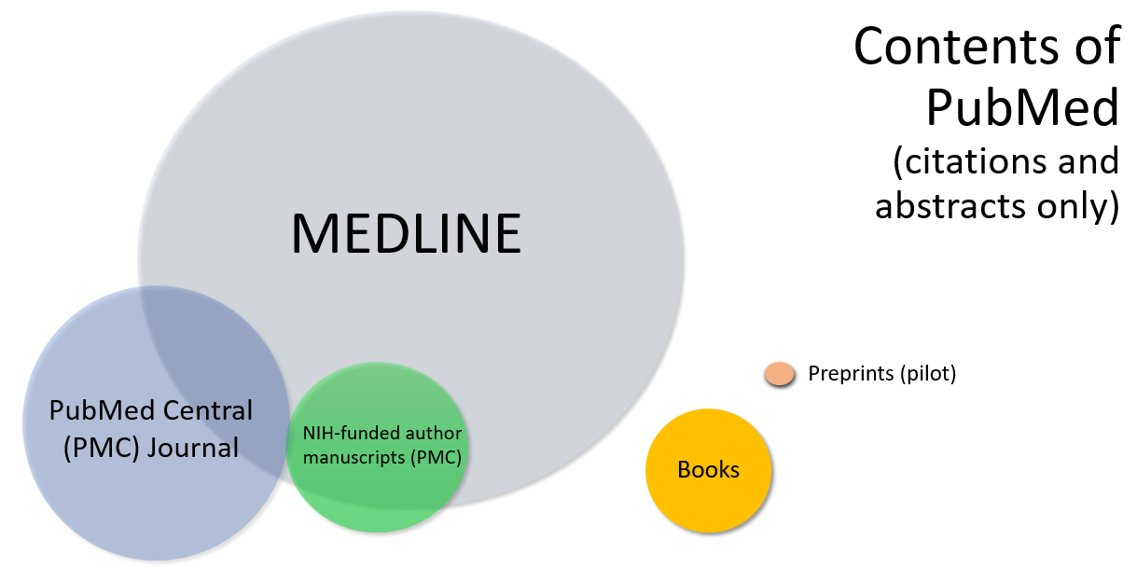

Slide 39
MESH SLIDES

Slide 40
Where is the Full Text?
Available from the Publisher
  Full text is not always free
  Check for access to your institution’s subscriptions
Included in PMC (PubMed Central)
  Manuscripts deposited to comply with public access policies
  Journal and publisher deposit agreements
  NLM digitization projects

Slide 41
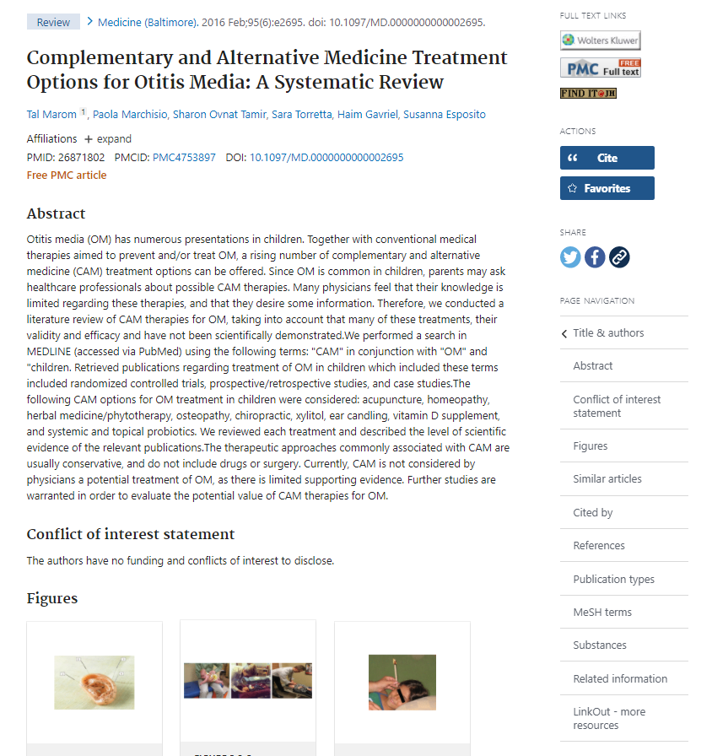
Sidebar Menu
Full Text Links
  Publisher icon
  PMC icon
  Up to 5 Library icons
Cite
Add to Favorites
Share
Page Navigation
Notes:
Exploring this record highlights some of the features of the new system:
The new PubMed sidebar menu has four main components:
[click] Your links to the full text, including up to 5 icons for your library subscriptions, to bring you and your patrons to your institution’s online subscriptions.
[click] Quick ways to save the citation information: The new Cite button, which I’ll show you in just a moment, and your Favorites button, which saves the citation to My NCBI.
- [click] Our social media links provide you a link back to PubMed, so you can easily share information with your colleagues on Twitter or Facebook.
[click] A navigation menu, to quickly get you to the part of the record of interest.

Slide 42
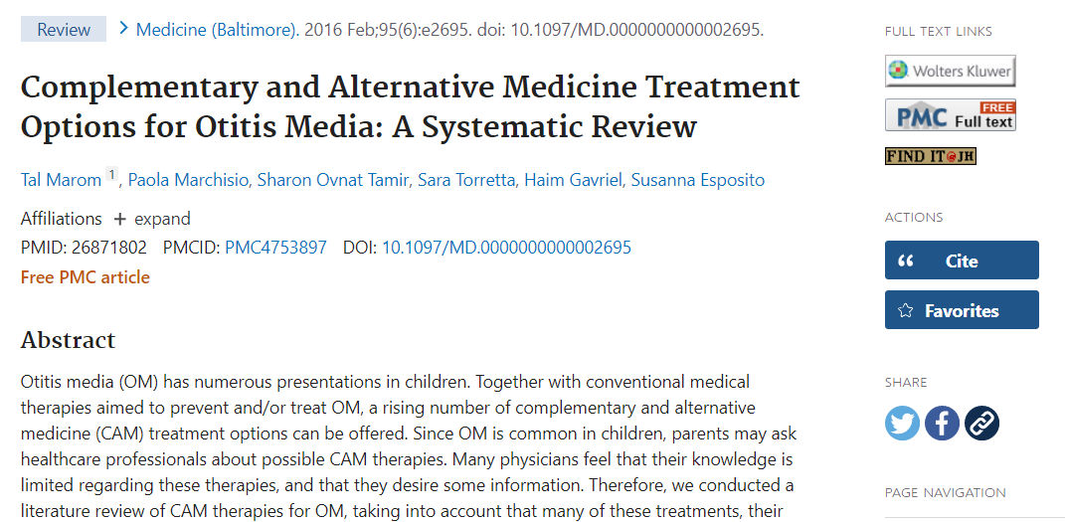
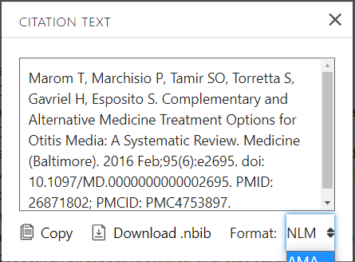

Cite
Citation in AMA, MLA, APA, and NLM formats
Copy citation text
Download .nbib

Slide 43
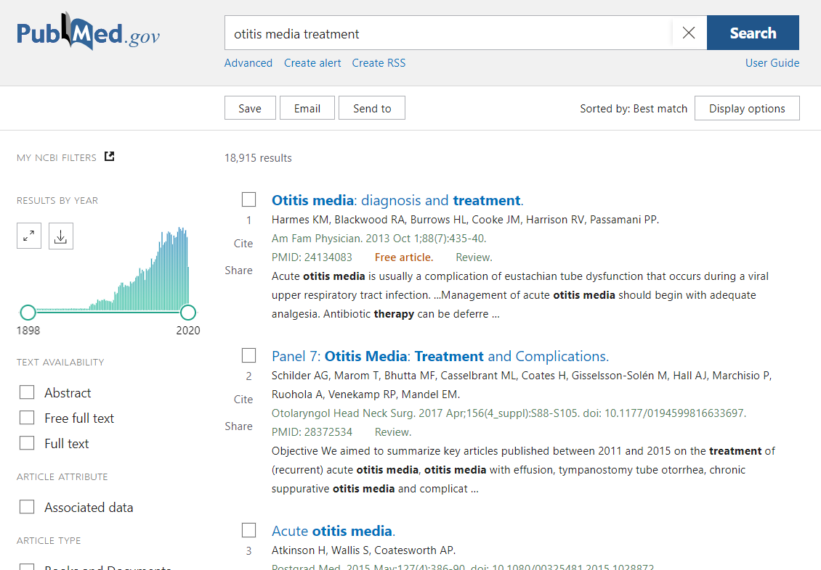
Results Page
Results by Year graph
Save, Email, Send to
Best Match by default
Abstract snippets with highlights
Filters
Advanced search
Create alert
Cite and Share

Slide 44
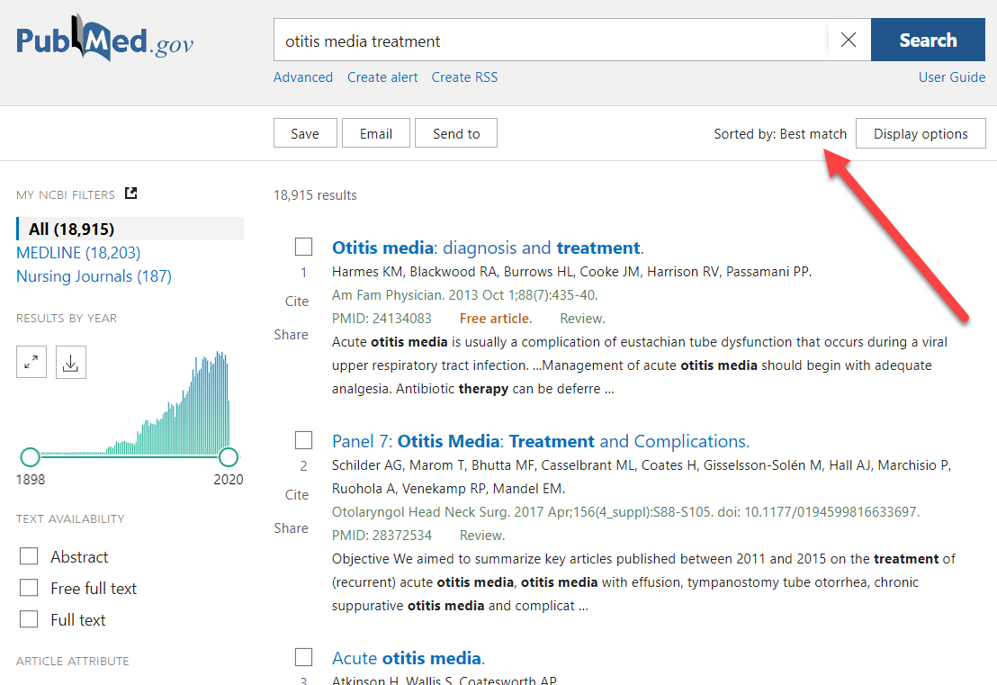
Best Match: New relevance sort for PubMed
By default the results are in Best Match sort order.
Important because >80% users click on first page results.
Click “Display options” button to switch sort order.

Slide 45
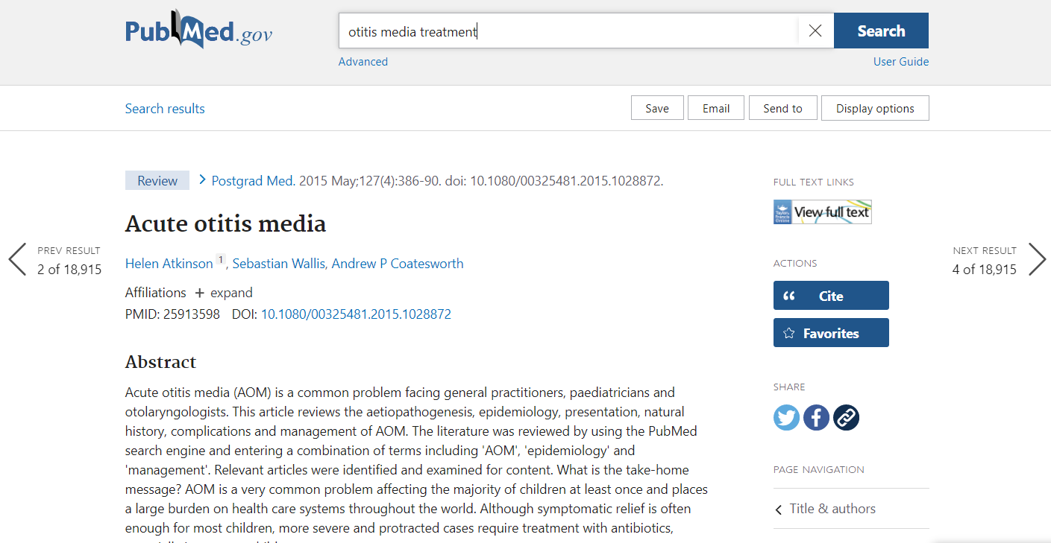
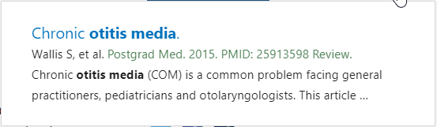
Previous & Next
< Previous
> Next
Hover for details

Slide 46
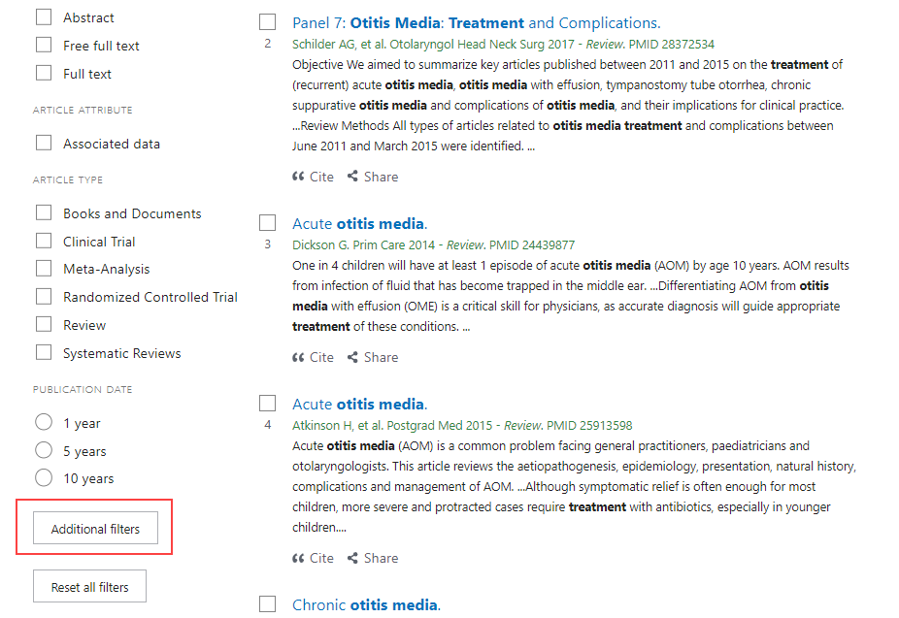
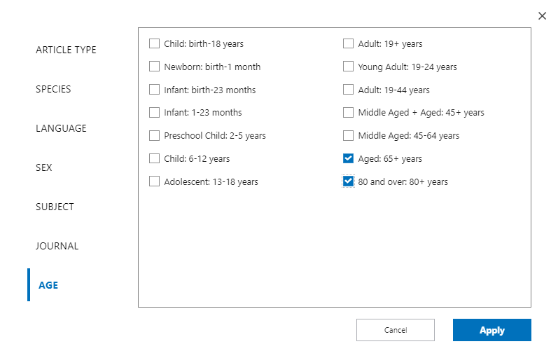
Filters

Slide 47
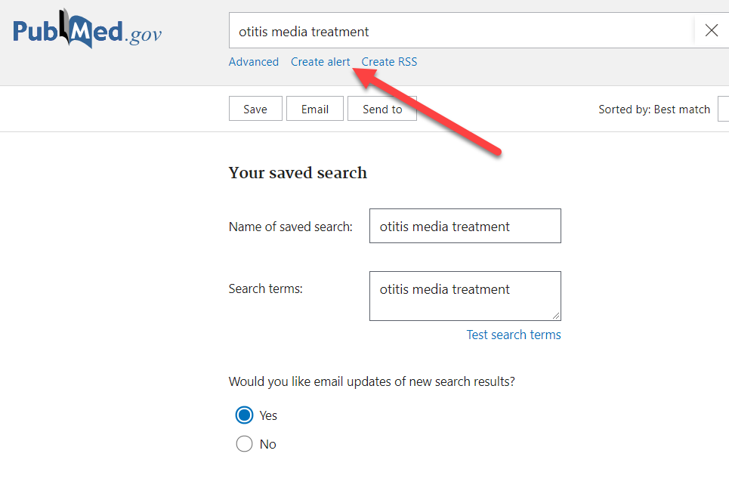
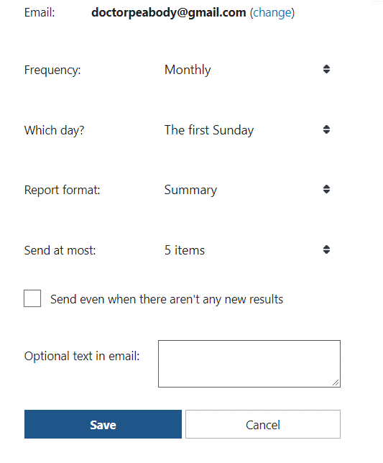
Create Alert

Slide 48
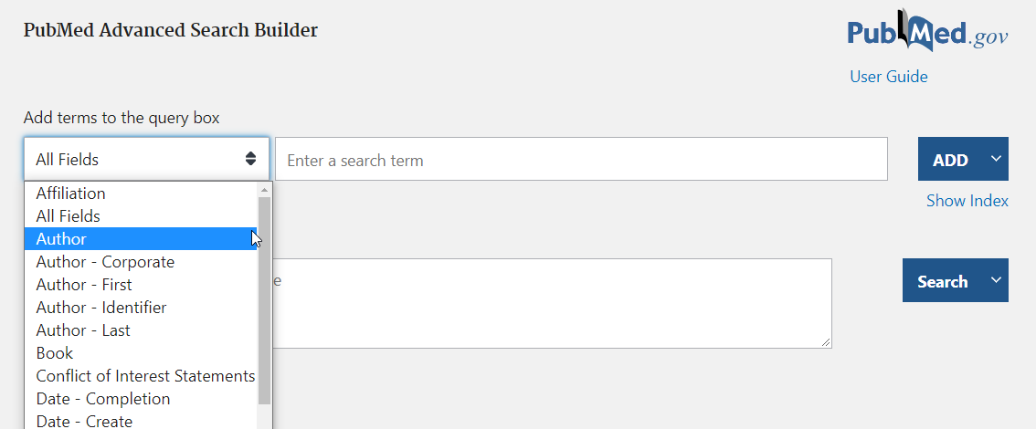
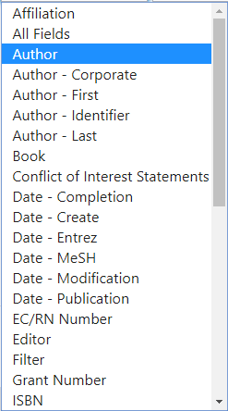
Advanced Search and History
Search specific fields
Show index
Build complex searches

Slide 49
PubMed search must be done in two ways and then the results must be combined:
A. Advanced Search
B. Mesh Search
Combine A and B: A OR B

Slide 50
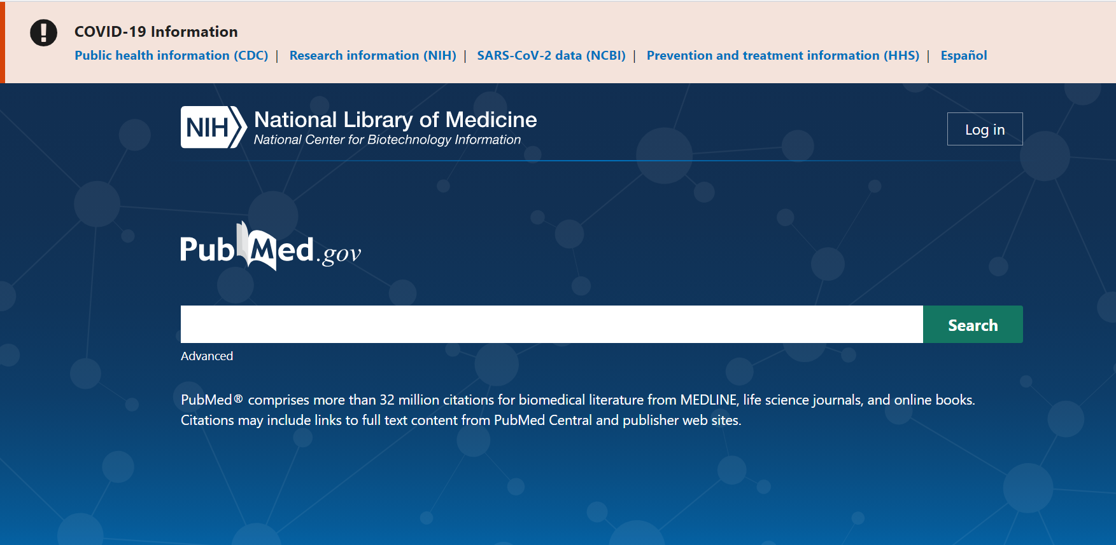
Advanced Search

Slide 51
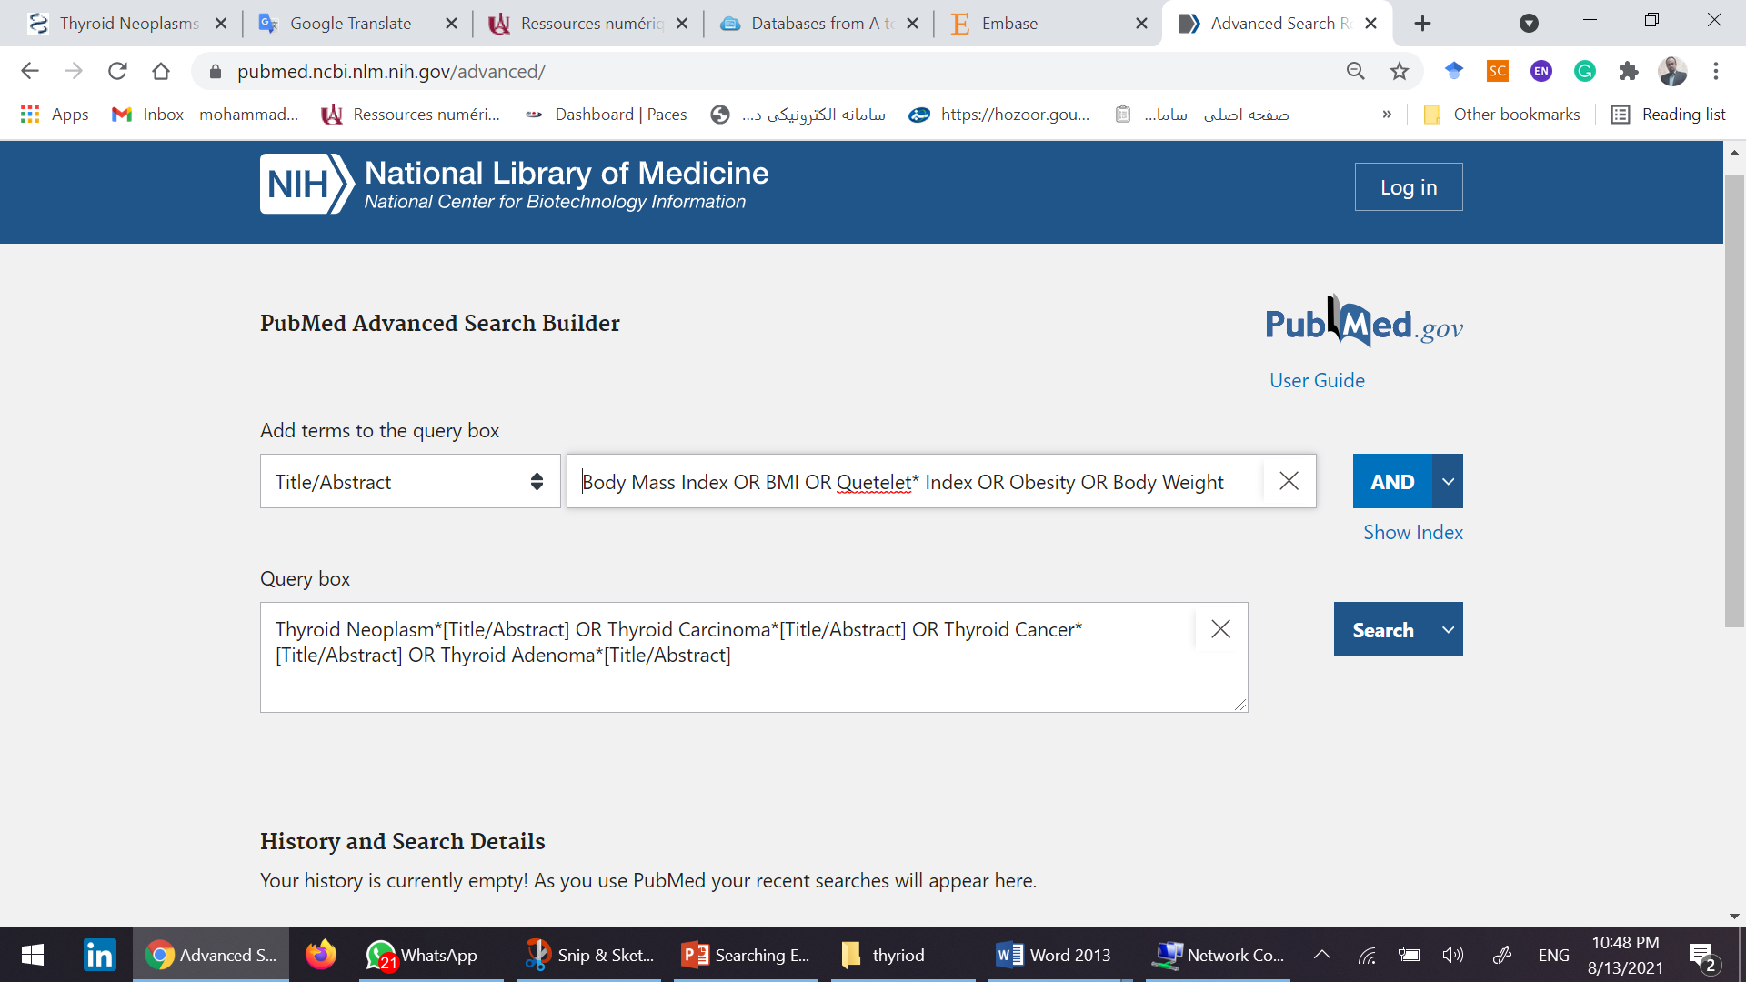
Use Title/Abstract field

Slide 52
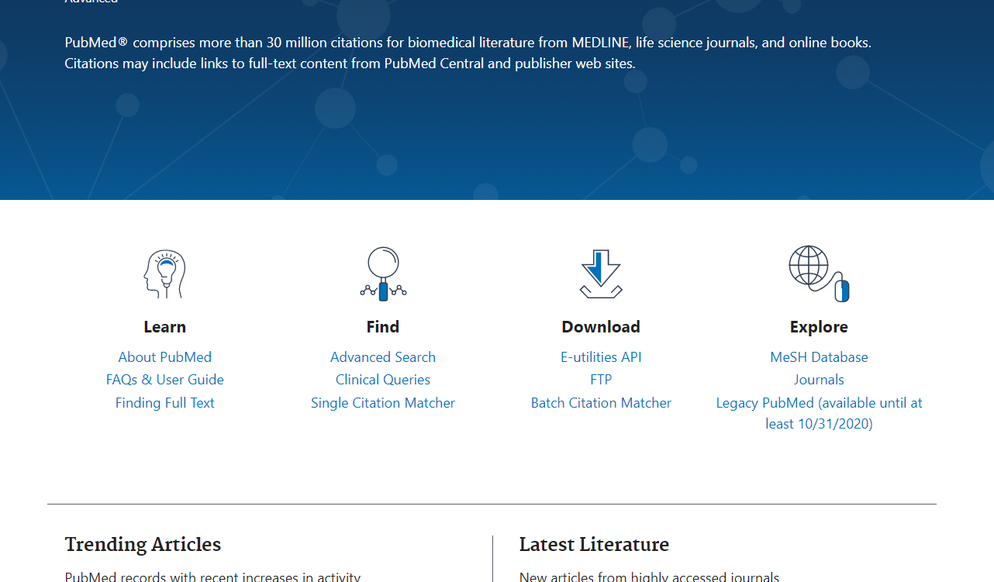
How to use Mesh
Select the Mesh via this link

Slide 53
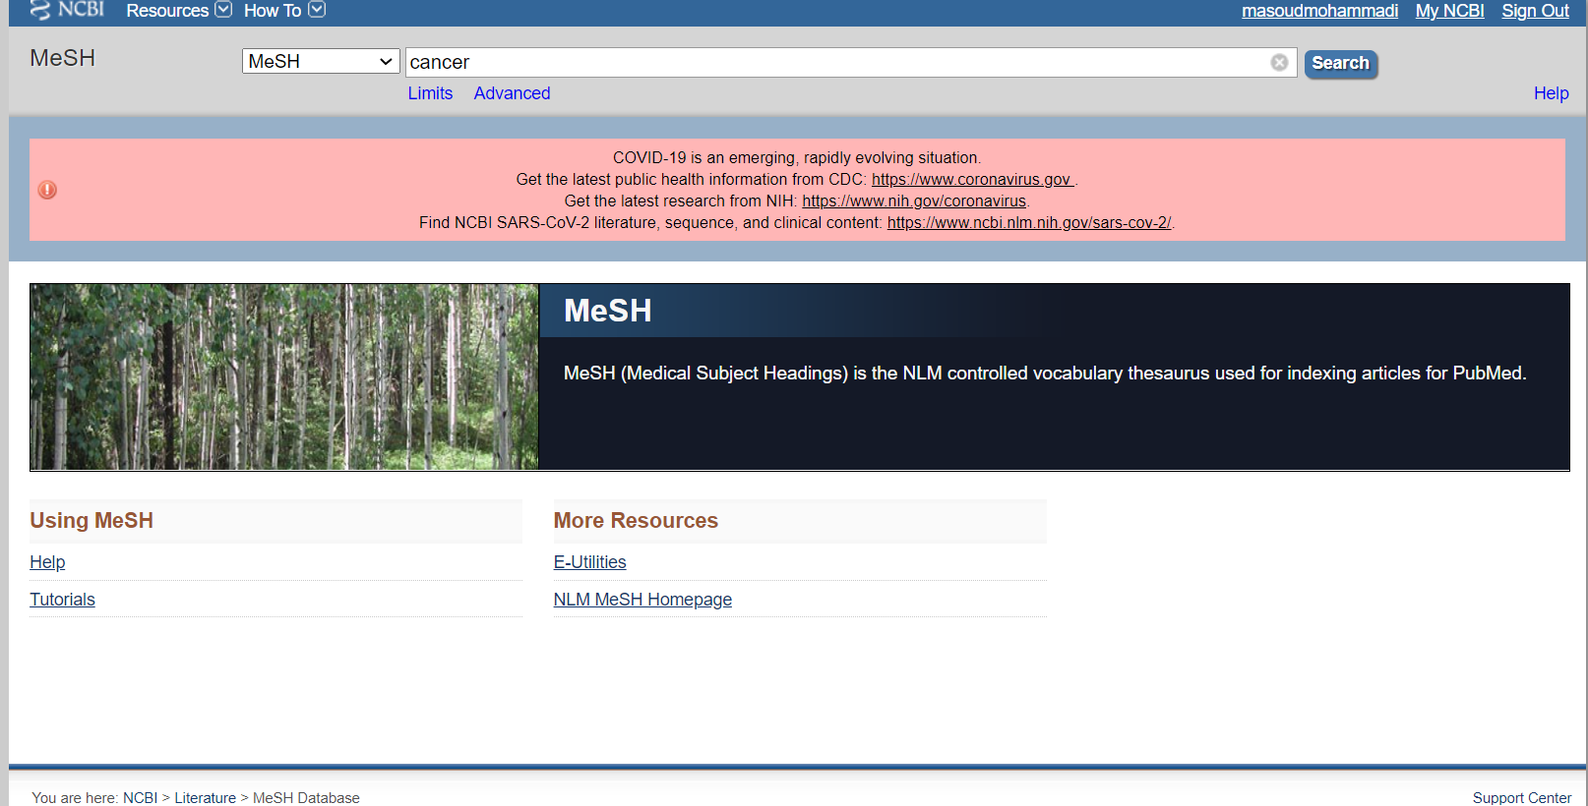
Type your concepts

Slide 54
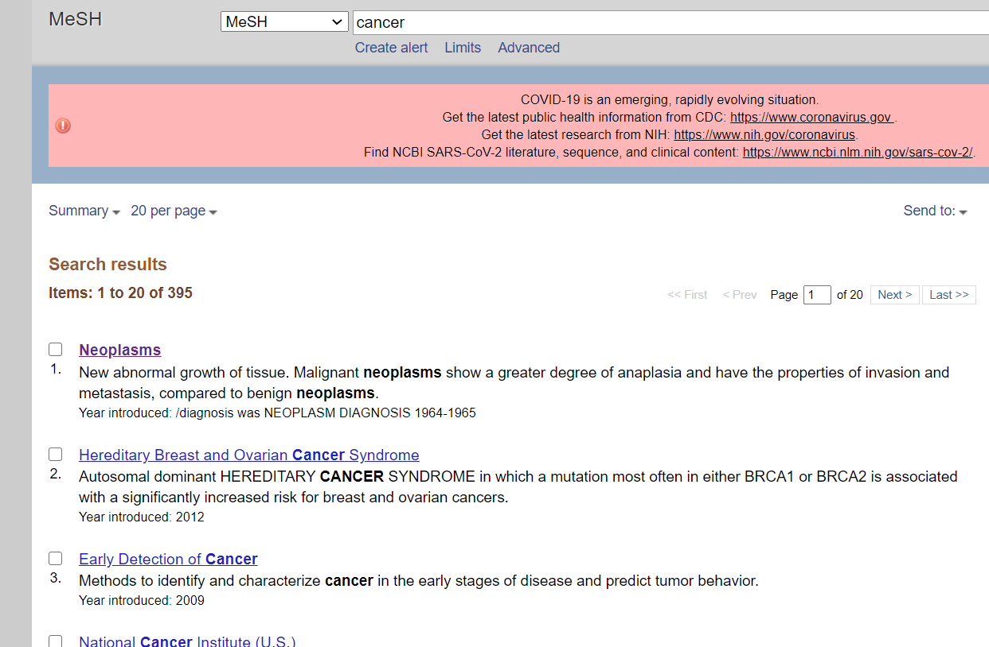
Selection preferred terms

Slide 55
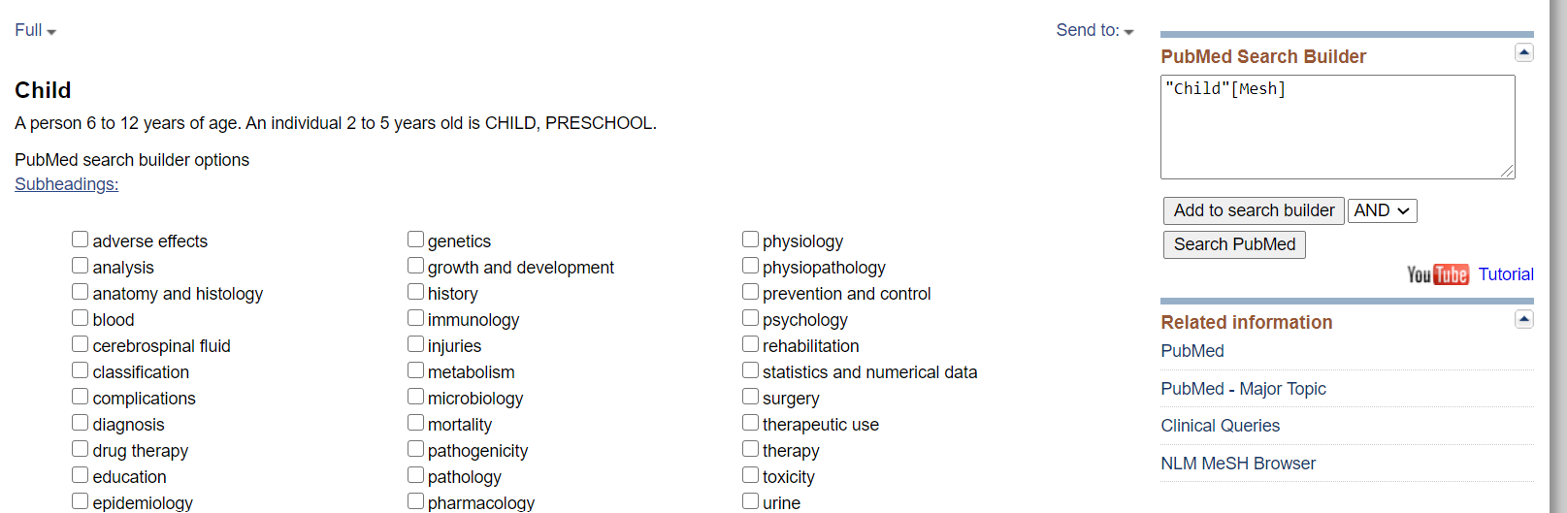
Add the word (title) to the search box and run the search

Slide 56
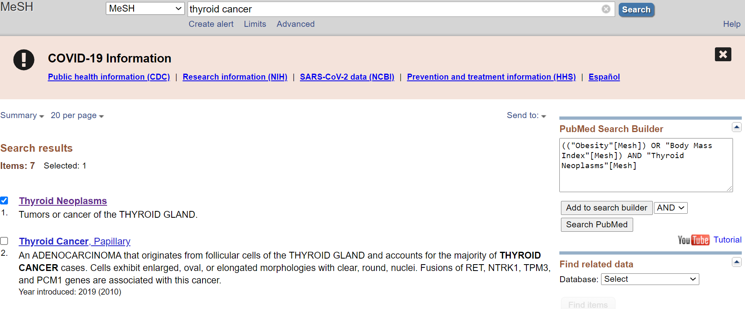

Slide 57
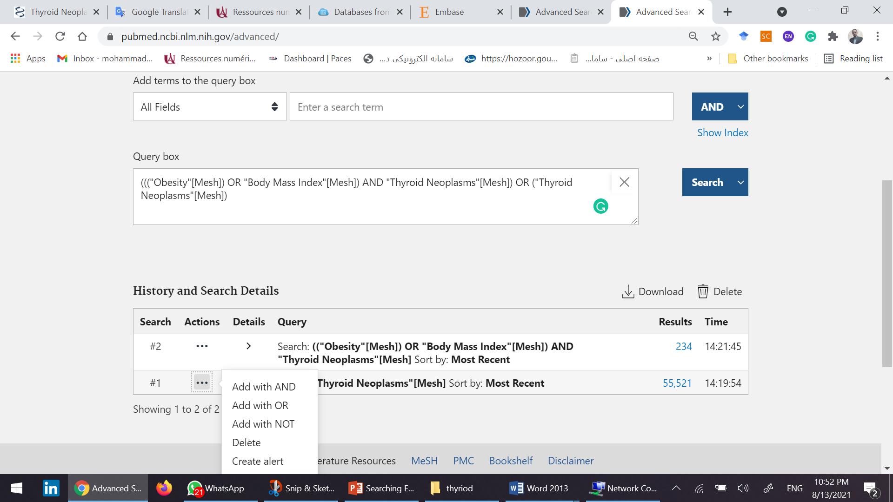
Using OR operator, combine mesh search results with advanced search results.

Slide 58
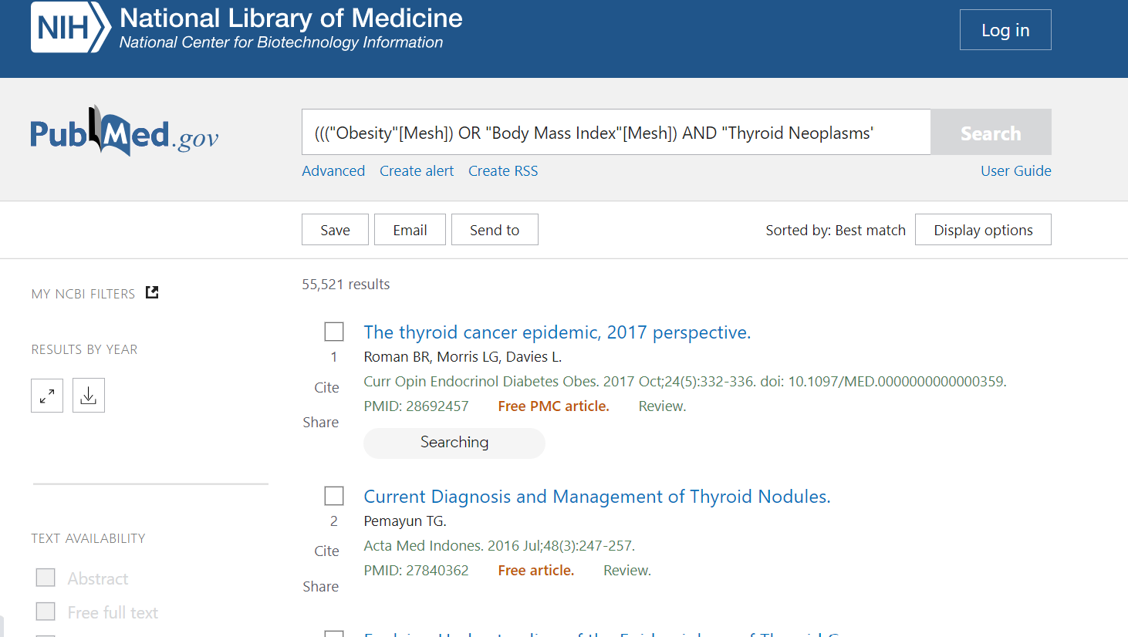
Export results using Send to

Slide 59
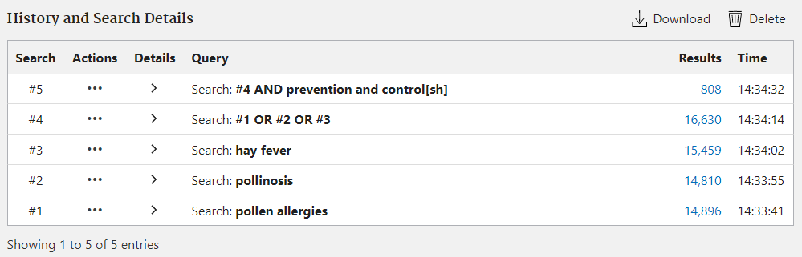
Search History
View and Download search history
Compare results of various searches
Combine previous searches
View search details
Download Search History

Slide 60
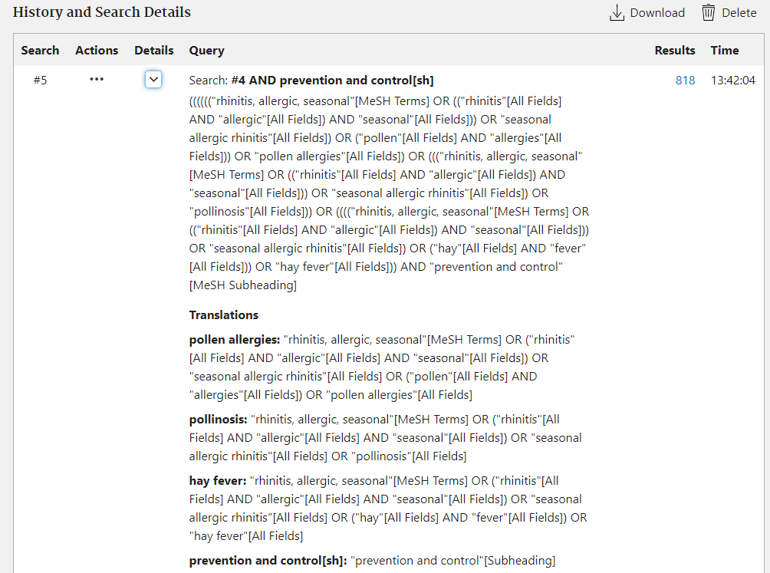
Search Details
View search details and translation

Slide 61
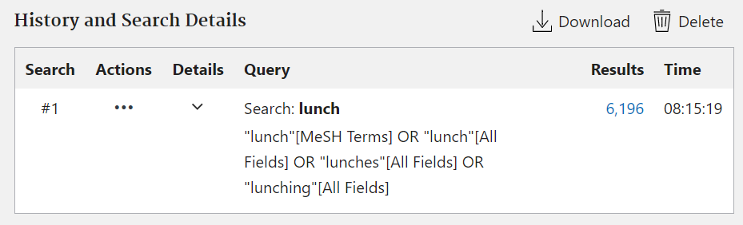
New Retrieval Features:
Enhanced Synonymy

Slide 62
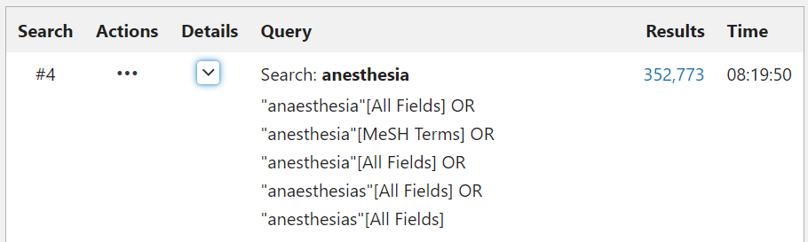
New Retrieval Features:
Better British/American Mapping

Slide 63
PubMed Clinical Queries
This tool uses predefined filters to help you quickly refine PubMed searches on clinical or disease-specific topics. To use this tool, enter your search terms in the search bar and select filters before searching.
PubMed Clinical Queries provides specialized searches for:
  COVID-19 Articles
  Clinical Study Categories
    Therapy, Etiology, Diagnosis, Prognosis, Clinical Prediction Guides
  Medical Genetics

Slide 64
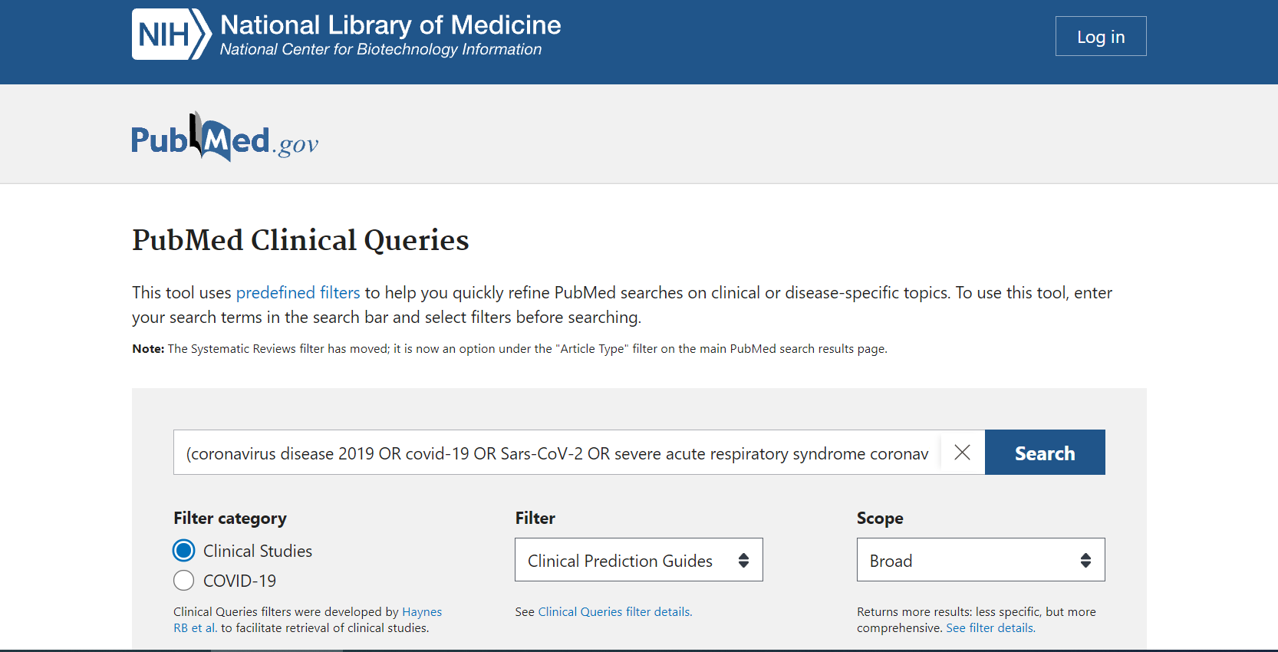

Slide 65
OpenI

Slide 66
Open-i
Open-i service of the National Library of Medicine enables search and retrieval of abstracts and images (including charts, graphs, clinical images, etc.) from the open source literature, and biomedical image collections. Searching may be done using text queries as well as query images. Open-i provides access to over 3.7 million images from about 1.2 million PubMed Central articles; 7,470 chest x-rays with 3,955 radiology reports; 67,517 images from NLM History of Medicine collection; and 2,064 orthopedic illustrations.
https://openi.nlm.nih.gov/

Slide 67
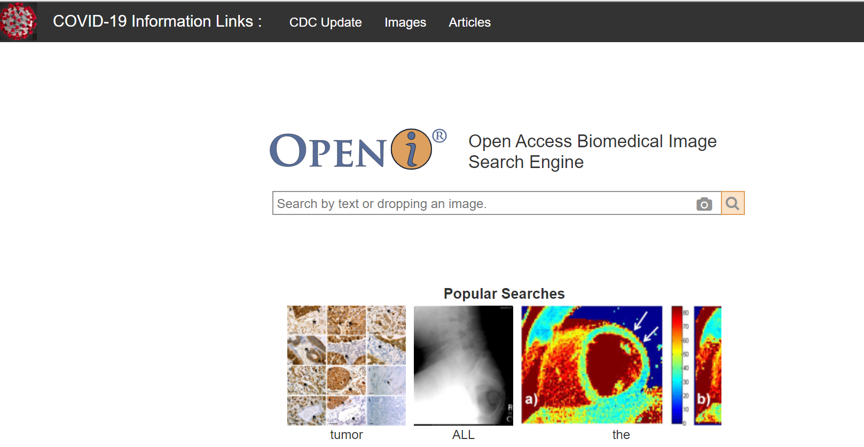
Like other databases, this database has special facilities for dealing with Covid-19

Slide 68
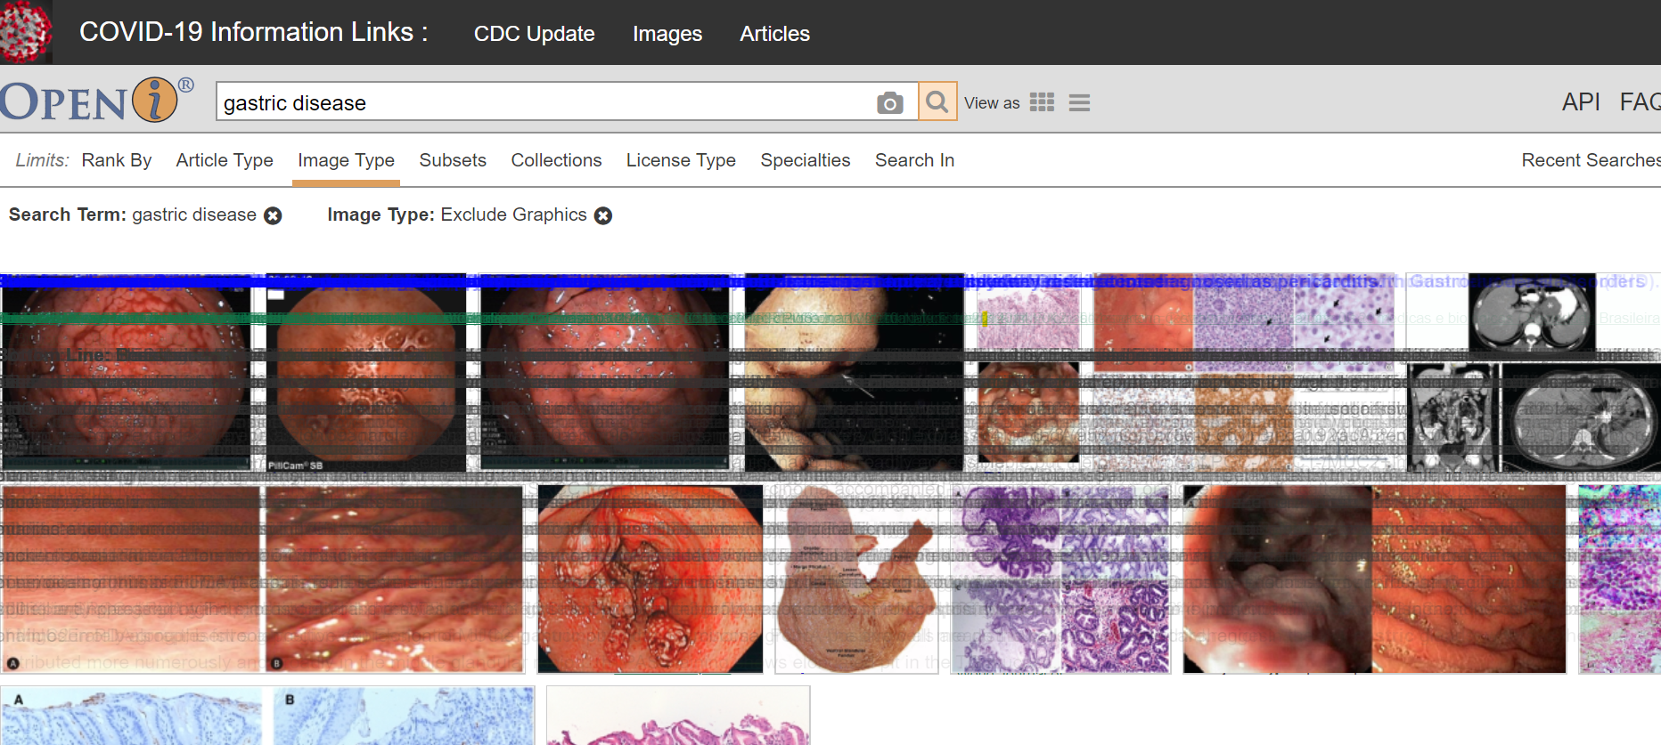

Slide 69
Web of Science

Slide 70
Citation Databases
Citation databases are databases that have been developed for evaluating publications. The citation databases enable you to count citations and check, for example, which articles or journals are the most cited ones
In a citation database you get information about who has cited an article and how many times an author has been cited. You can also list all articles citing the same source.
Most important citation database are
“Web of Science”,
“Scopus”
“Google Scholar”

Slide 71
Web of Sciences
Web of Science is owned and produced by Clarivate Analytics. WoS is composed of three databases containing citations from international scientific journals:
  Emerging Source Citation Index- ESCI
  Arts & Humanities Citation Index - AHCI
  Social Sciences Citation Index - SSCI
  Science Citation Index – SCI
Journal Coverage:
  Aims to include the best journals of all fields.
Citation Coverage:
  Includes citations starting from the year 1945
  Citations can be counted in a simple or complex manner, with different results

Slide 72
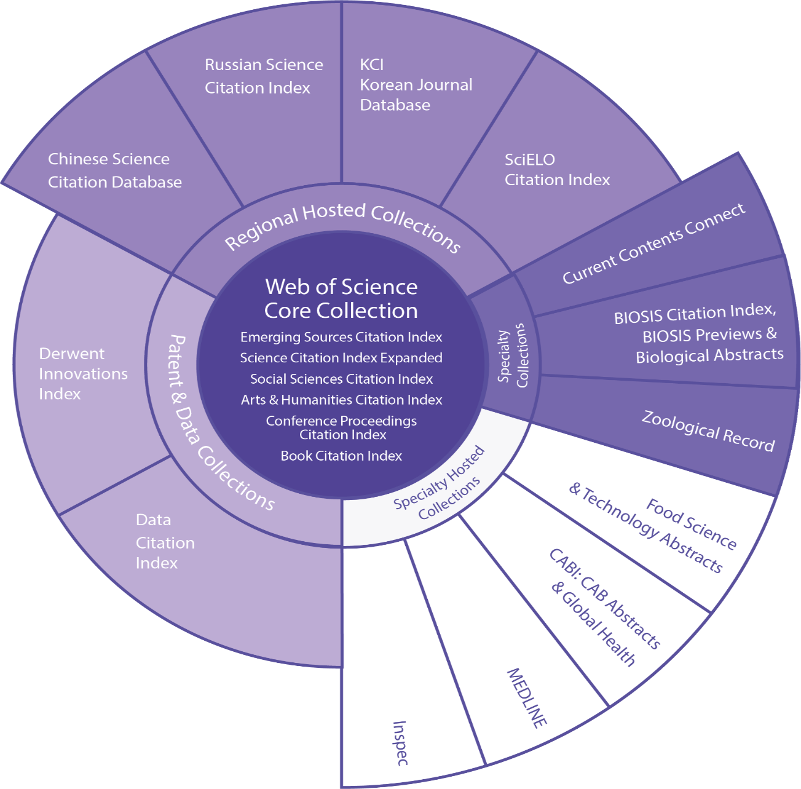
What is Web of Science?
Web of Science is a platform consisting of several literature search databases designed to support scientific and scholarly research.
Web of Science Core Collection is premier resource on the platform and includes over 21,000 peer-reviewed, high-quality scholarly journals published worldwide (including Open Access journals); over 205,000 conference proceedings; and over 104,000 editorially selected books.
Note: Your institution's entitlement to the Web of Science platform may not include all these databases.

Slide 73
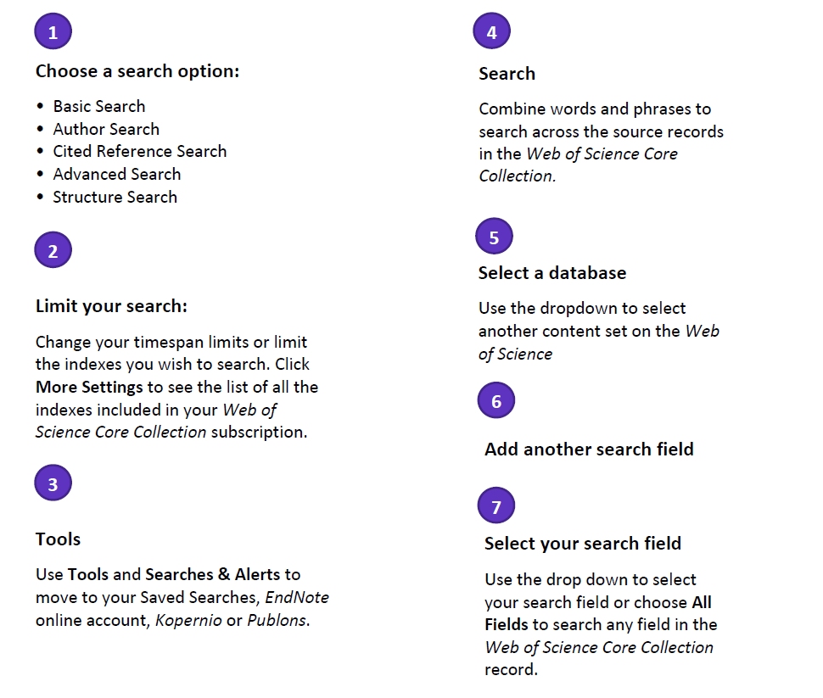
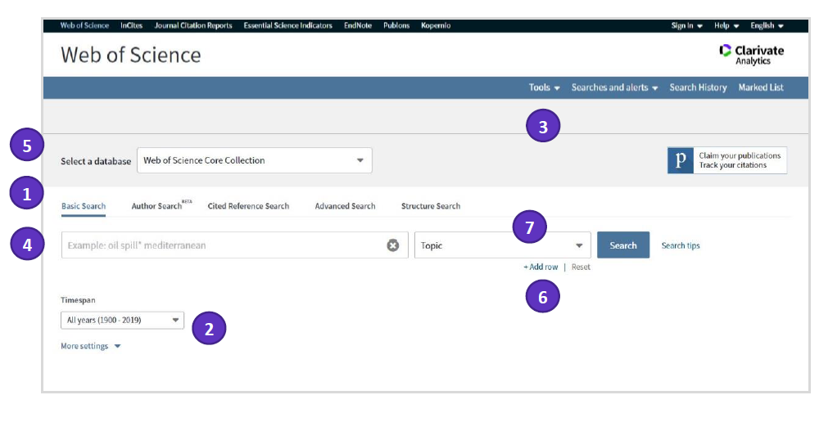
Basic search

Slide 74
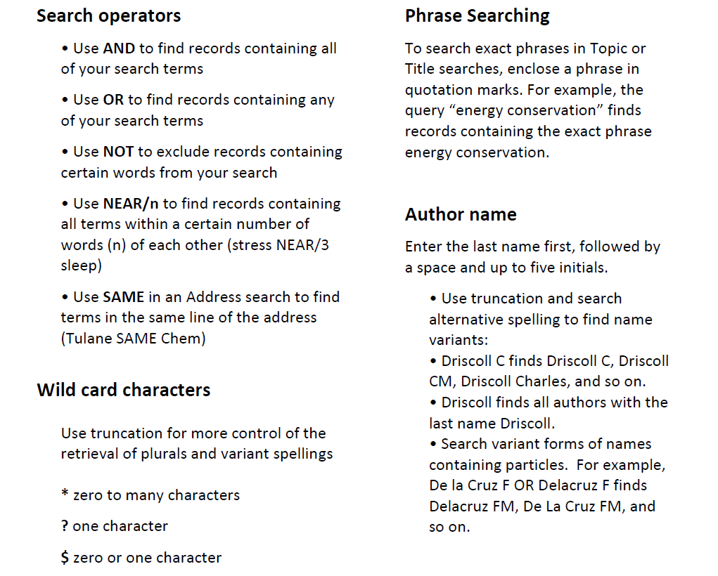

Slide 75
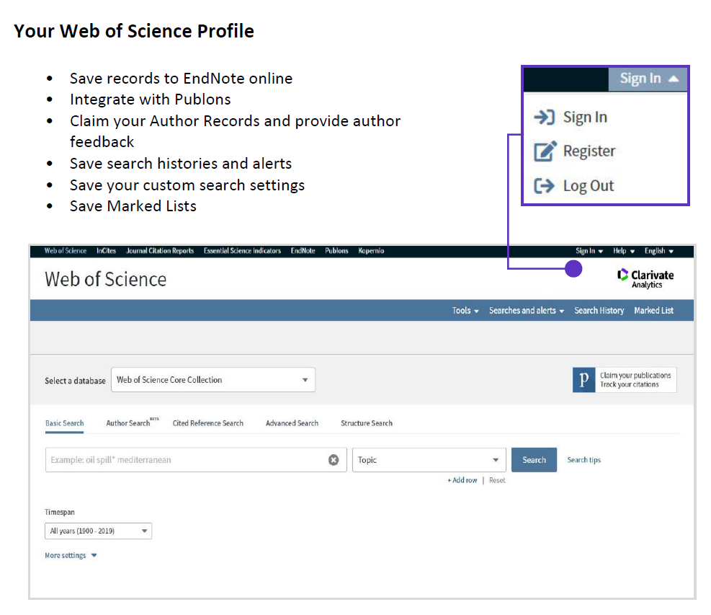

Slide 76
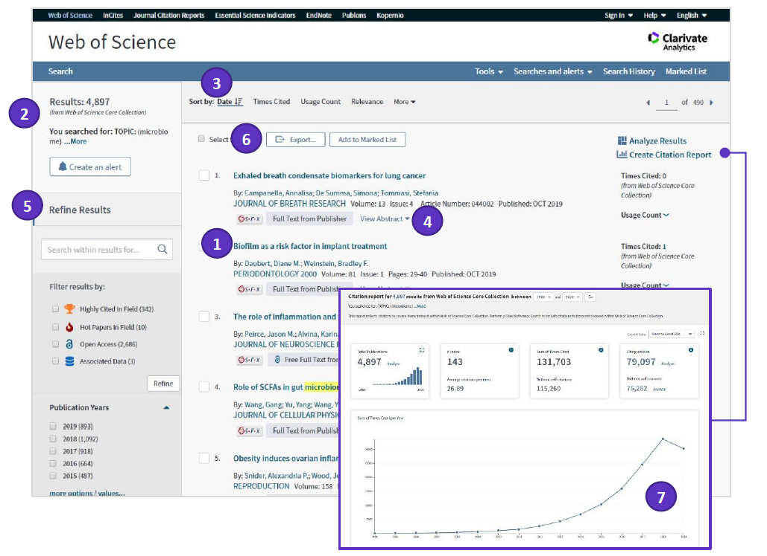
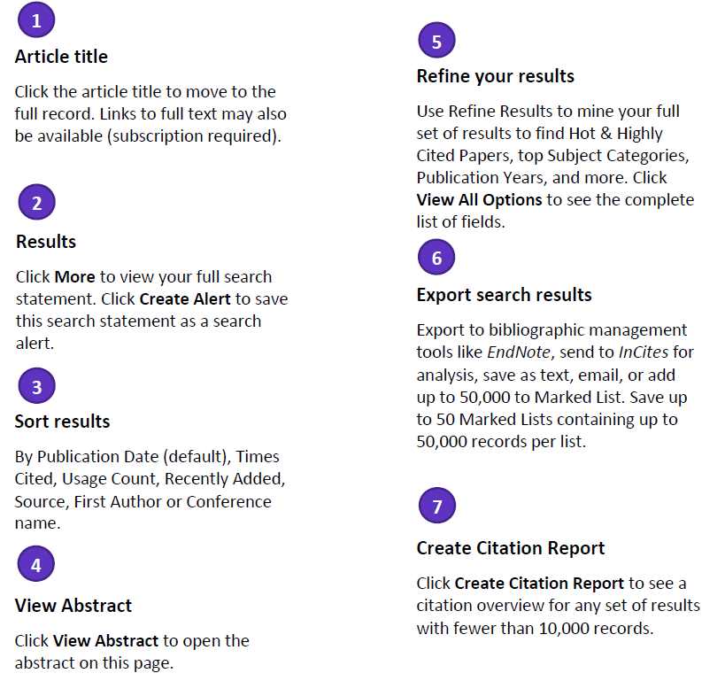

Slide 77
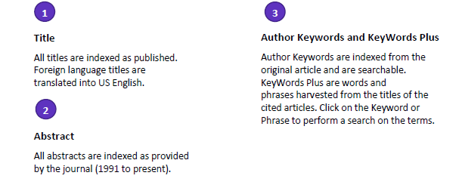
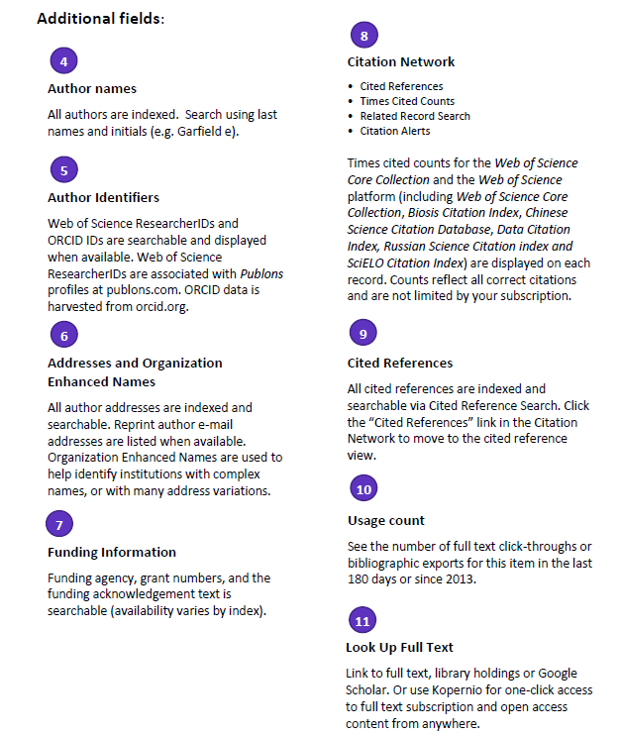
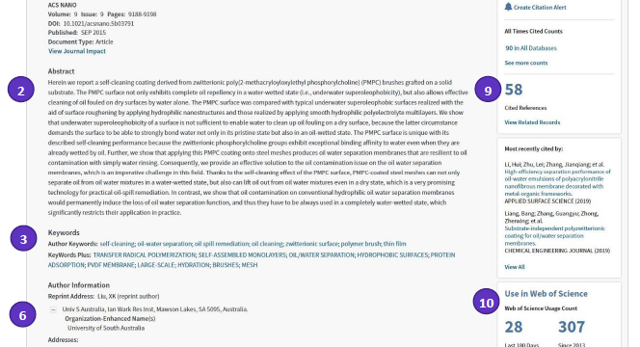

Slide 78
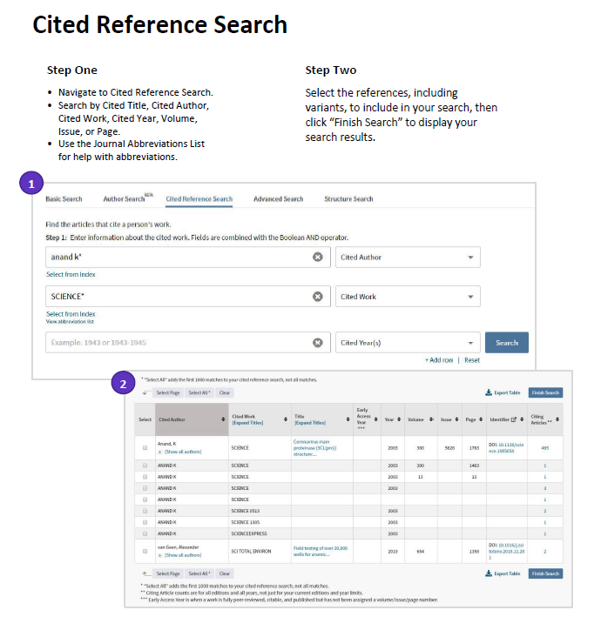
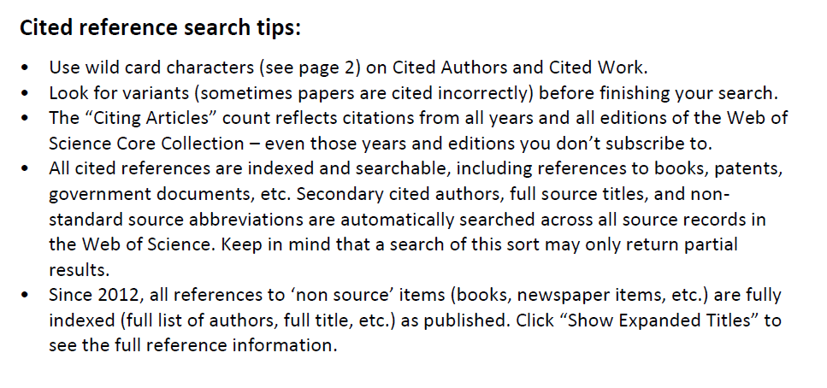

Slide 79
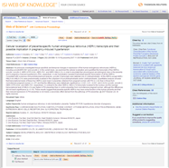
What is a citation?
2004
2008
Times Cited
2003
2000
2009
Cited References
2000
Related Records
1974
1998
2008
1993
1999
2002
2000

Slide 80

Metrics
Science Citation Index
Expanded
Social Sciences and Arts&Humanities Citation Index
Journal-level data
Researcher-level data
Institution-level data
Country/region-level data
Field/discipline-level data
Article-level data

Slide 81
Journal Citation Reports®
Journal Citation Reports aggregates the meaningful connections of citations created by the research community through the delivery of a rich array of publisher-independent data, metrics and analysis of the world’s most impactful journals included in the Science Citation Index Expanded (SCIE) and Social Sciences Citation Index (SSCI), part of the Web of Science Core Collection.
Journal Citation Reports is the only journal report of its kind that is both complete and editorially selective; it contains all the data required to understand the components that index the value and impact of each journal. The structured data are curated by a global team of experts who continuously evaluate and select the collections of journals, books and conference proceedings covered in the Web of Science Core Collection to ensure accuracy in evaluating journal impact.
These expert insights enable you to explore the key drivers of a journal’s value, making better use of the wide body of data and metrics available in the Journal Citation Reports, including the Journal Impact Factor (JIF(

Slide 82
Key features in the Journal Citation Reports allow you to:
  Focus on desired subject categories, enabling you to review journal titles and key performance indicators in the category;
  Compare multiple journals based on a chosen indicator;
  Evaluate the performance of journals in which you or your organization has published research;
  Recognize trending journals in key research categories;
  Identify the ideal journal in which to publish your forthcoming research;

Slide 83
Journal Information Provided by JCR
Total Cites
Impact Factor
5-Year Impact Factor
Immediacy Index
Cited Half-Life
Citing Half-Life
Eigenfactor Score
Article Influence

Slide 84
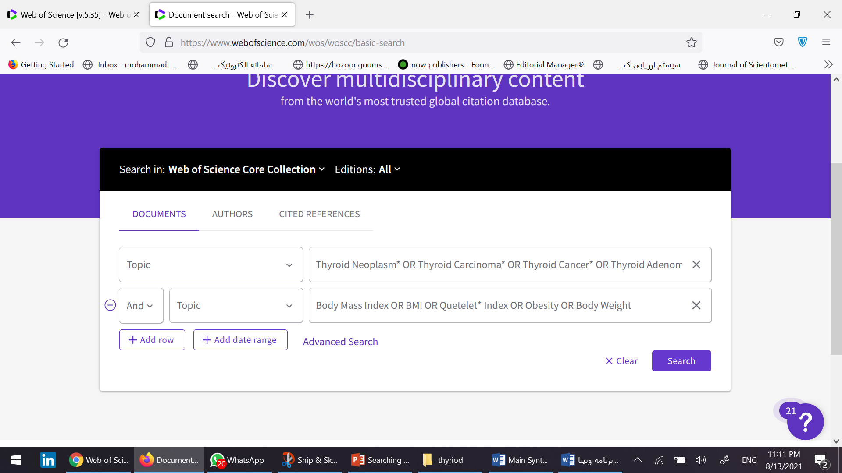
Searching topics in WoS (new interface)
Use the Topic field to search this database.
topic Searches for titles, abstracts, author keywords, and index keywords.

Slide 85
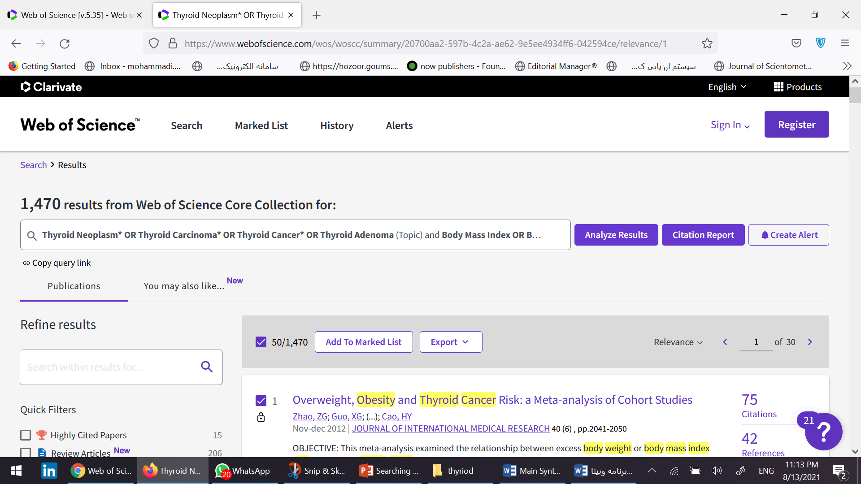
Get output from the results using the Export option.

Slide 86
Scopus

Slide 87

Use “Article title, Abstract, Keywords field in Scopus.
The key to Scopus search is to put phrase concepts in parentheses.
Otherwise your results will not be retrieved correctly.

Slide 88

Get your standard output using Export

Slide 89

At the time of output, check the Abstract & Keyword option to get the output with maximum information.
This simplifies your work in the screening stage.

Slide 90
About Scopus
Scopus launched in November 2004. Scopus is a source-neutral abstract and citation database curated by independent subject matter experts.
With over 25,100 titles from more than 5,000 international publishers, Scopus delivers the most comprehensive overview of the world’s research output in the fields of science, technology, medicine, social science, and arts and humanities.

Slide 91

Publishers indexed in Scopus

Slide 92
Scopus at a glance
Over 25,100 titles
  Over 23,452 peer-reviewed journals (including 5,500 full open access journals)
  294 trade publications •
  Over 852 book series •
  Over 9.8 million conference papers from over 120,000 worldwide events
Articles-in-Press” from over 5,500 journals
Over 77.8 million records:
  Over 71.2 million records post-1969 with references
  Over 6.6 million records pre-1970, with the oldest record dating back to 1788
Patents:
  • More than 44 million patent records from five patent offices

Slide 93

Searching documents in Scopus
Enter your search terms into the Search documents box [1]
  By default, Scopus will search in the Article title, Abstract and Keywords of documents
You can specify in which fields to search using the drop-down menu [2].
Use the +Add search field [3] option to add additional fields
Each new search field is combined using the Boolean operators AND, OR, and NOT [4]
To see a complete list of advanced field codes, select Advanced document search [5]

Slide 94

Document results page

Slide 95

Open Access filters
On the document details page, you can filter by Open Access types, including:
  Gold open: Documents that are in journals which only publish open access
  Hybrid Gold: Documents that are in journals which provide authors the choice of publishing open access
  Bronze: Published version of record or manuscript accepted for publication; the publisher has chosen to provide temporary or permanent free access
  Green: Published version or manuscript accepted for publication, available at repository

Slide 96

Affiliation search
When you search by affiliation, just type the affiliation's name. The search will begin to auto-populate.

Slide 97

Author search
When you search by authors, you can search by last and/or first name. You also have the option to search by ORCID iD.

Slide 98

What is a Scopus Author Profile?
Scopus Author Profiles allow researchers to:
  Showcase research output
  Demonstrate impact and collaborations
  Update personal and departmental websites, CV’s and institutional profiles
Author Profiles allow potential employers and funding agencies to:
  Evaluate your work quickly and easily in one place
  Inform hiring and promotion decisions
  Decide which researchers or teams of researchers will receive research grants

Slide 99


Slide 100


Slide 101


Slide 102


Slide 103

Note!!!
Don’t forget after selecting journal, check this journal with ministry of health's journal black list system, its too important!!
http://blacklist.research.ac.ir/

Slide 104


Slide 105
اکثر اسلایدها متعلق به آقای دکتر مسعود محمدی است که ضمن تشکر فراوان از ایشان و با کسب اجازه شان جهت آموزش استفاده شده است.

